Slide 1
Integral Mission in a Christian Minority Context

Slide 2
WORLD RELIEF STAFF
Lauren Allgood – Strategic Partnerships Director, Southeast
Kirby Holmes – Strategic Partnerships Director, Texas & Central
Adula Gemta – Deputy Humanitarian Disaster Response Director
Brandon Prichard – Country Director, Cambodia

Slide 3
CHRISTIAN MINORITY CONTEXT

Slide 4
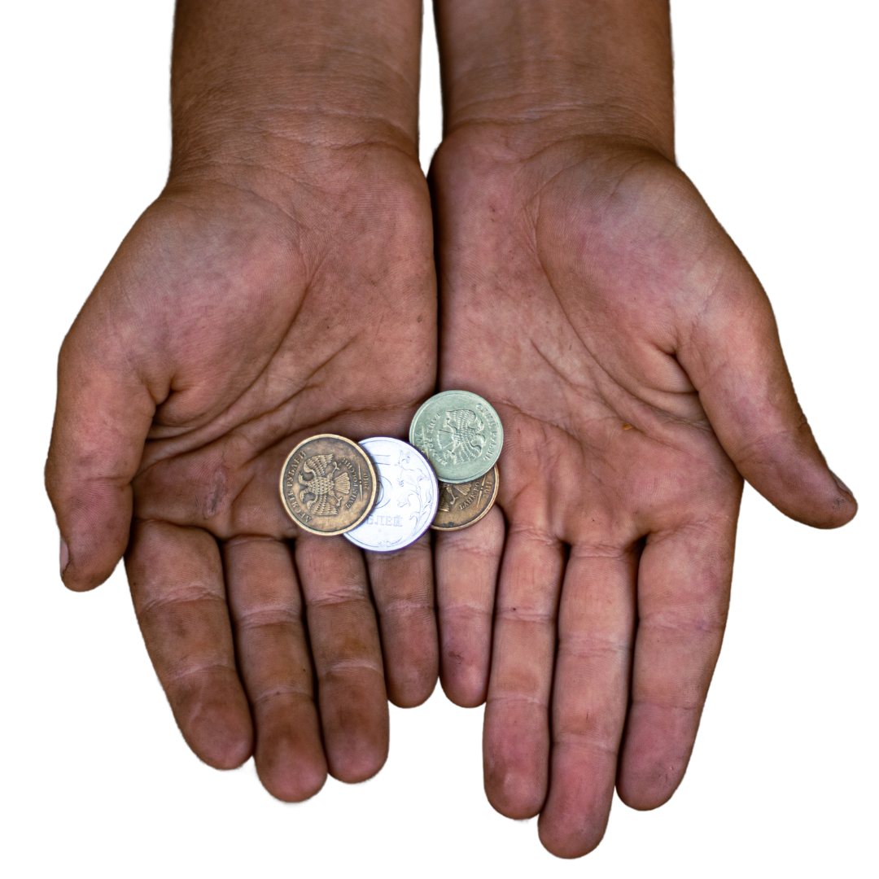
ADDITIONAL: POVERTY CONTEXT

Slide 5
WHAT IS INTEGRAL MISSION?

Slide 6
CASE STUDY: CAMBODIA
CONTEXT:
How would you take action to meet physical and spiritual needs into this context?

Slide 7
CASE STUDY: CAMBODIA
CONTEXT:
ACTION: World Relief did…
RESULTS: What happened…

Slide 8
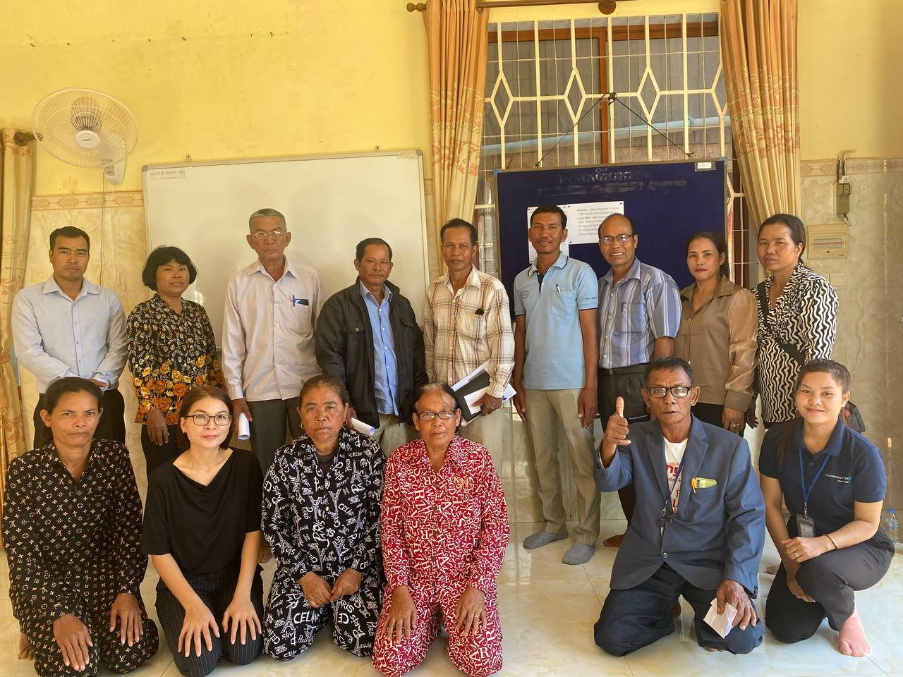
ACTION: CAMBODIA
2023 – church partnership option ​
8 church partners and, initially, 20 church volunteers and 59 project participants! ​
Including ​
Church orientations​
Church agreements ​
Church volunteer agreements ​
Church volunteer checklists ​
Routine trainings, refreshers​
Support from church facilitator​
FY24—unreached area, 78 project participants!​

Slide 9
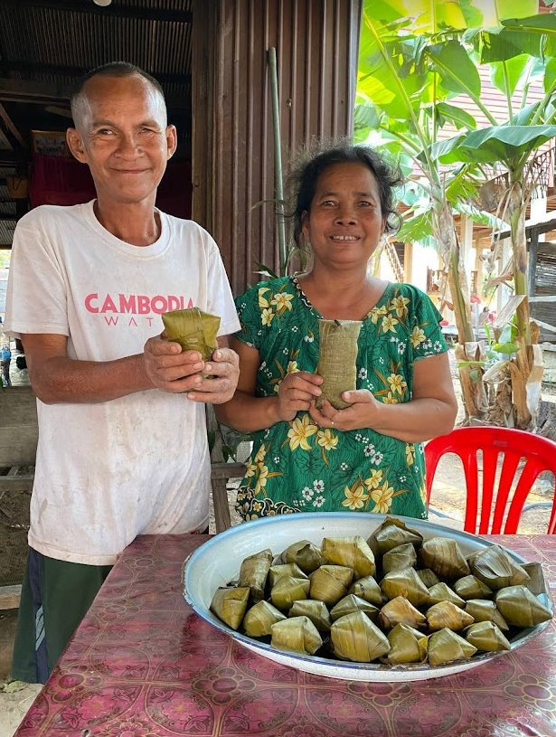
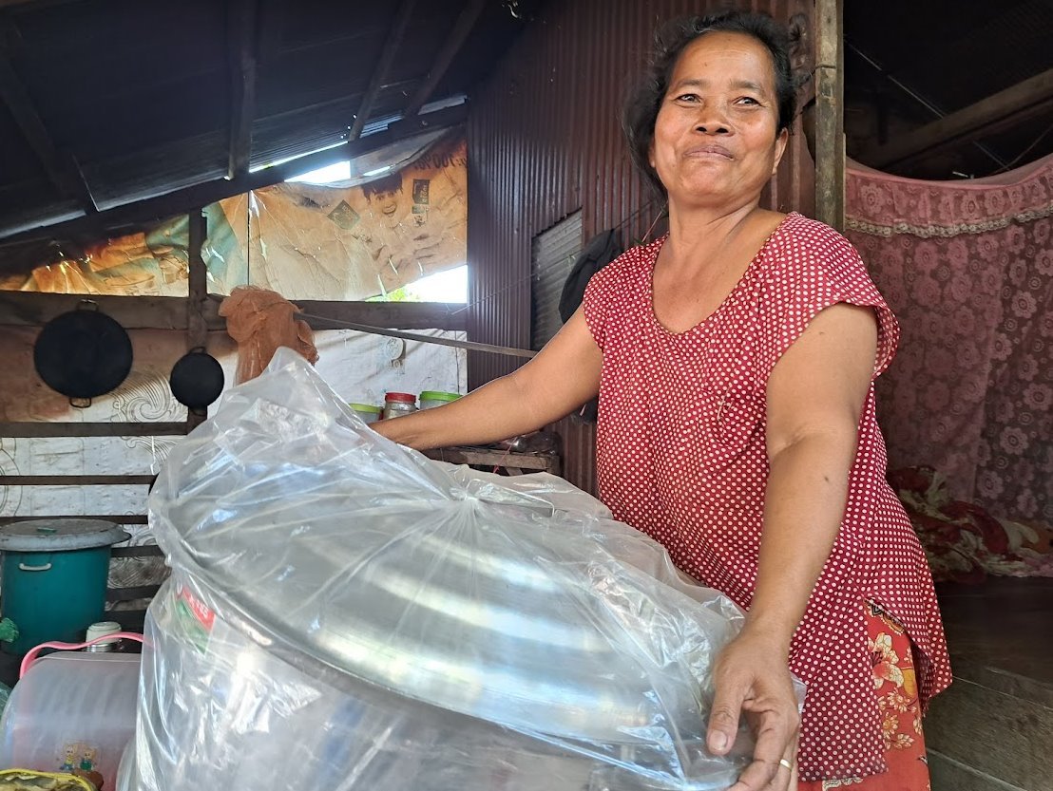
RESULTS: CAMBODIA

Slide 10
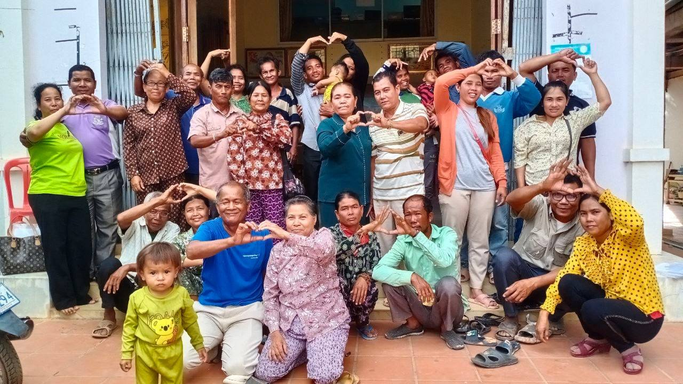
RESULTS: CAMBODIA

Slide 11
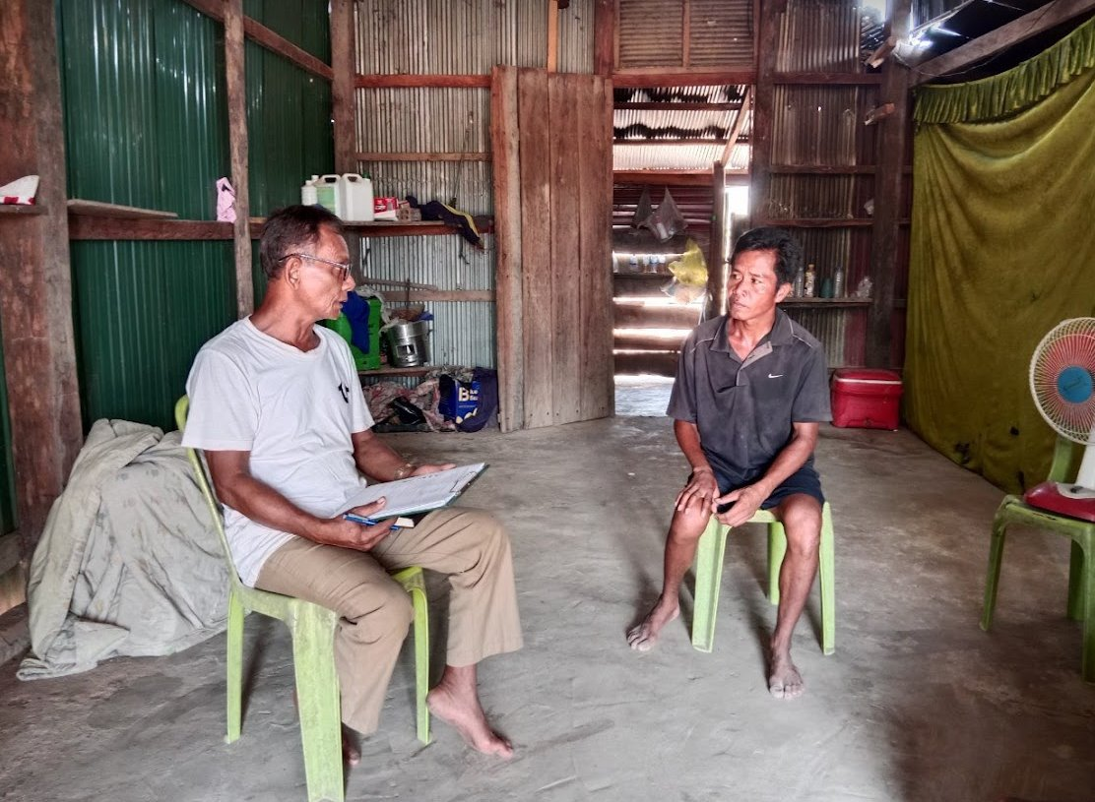
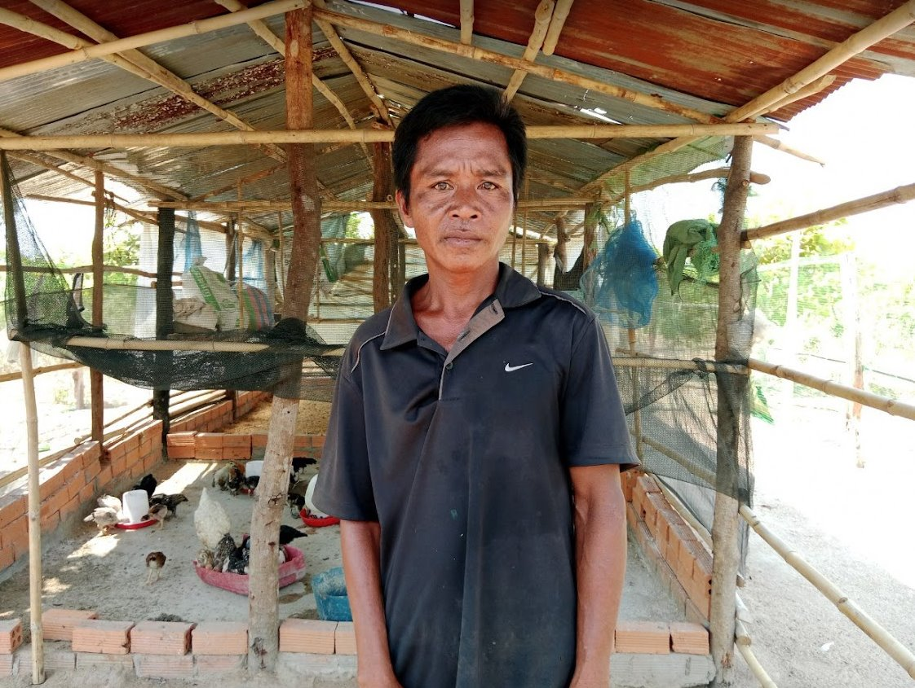
RESULTS: CAMBODIA

Slide 12
CASE STUDY: SUDAN
CONTEXT:
How would you take action to meet to meet physical and spiritual needs in this context?

Slide 13
CASE STUDY: SUDAN
CONTEXT:
ACTION: World Relief did…
RESULTS: What happened…

Slide 14
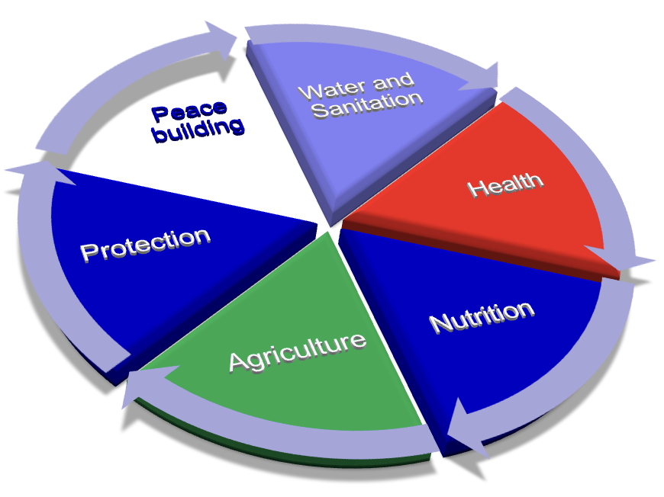
ACTION: SUDAN

Slide 15
ACTION: SUDAN
Our Approach:
World Relief (WR) acts like Church, representing Church where churches are non-existent.
Recruit Christian International staff.
WR Christian staff pray for the country, take all the opportunity to share the good news (individuals, groups) and live exemplary life.
The Sudanese community, don’t pay attention to what you say, but they do to how serious you are in your religious activities and your deeds.
Expand our program to locations where churches are existent and work with them;
Closely work with Chad Churches for cross-boarder mission;

Slide 16
CASE STUDY: SUDAN
WR Sudan is reaching out to over one million conflict affected people through its programs.

Slide 17
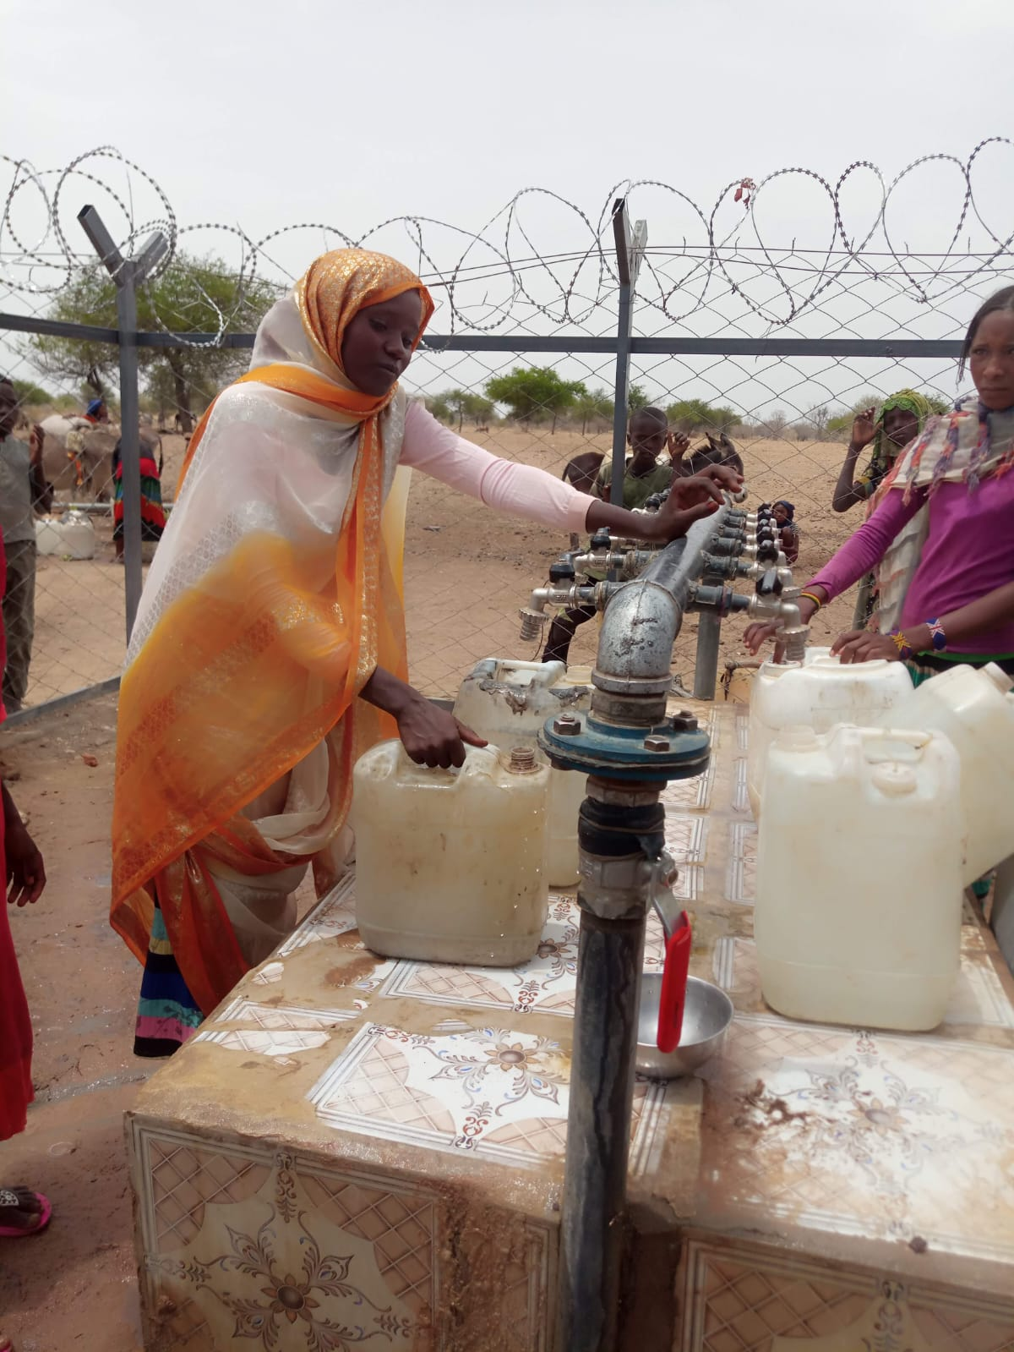
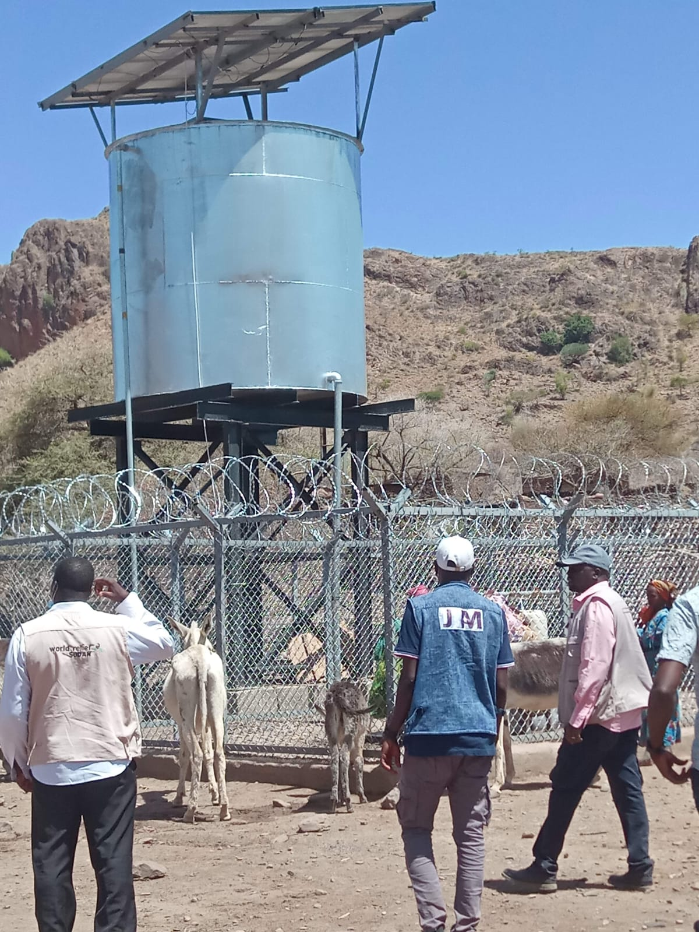
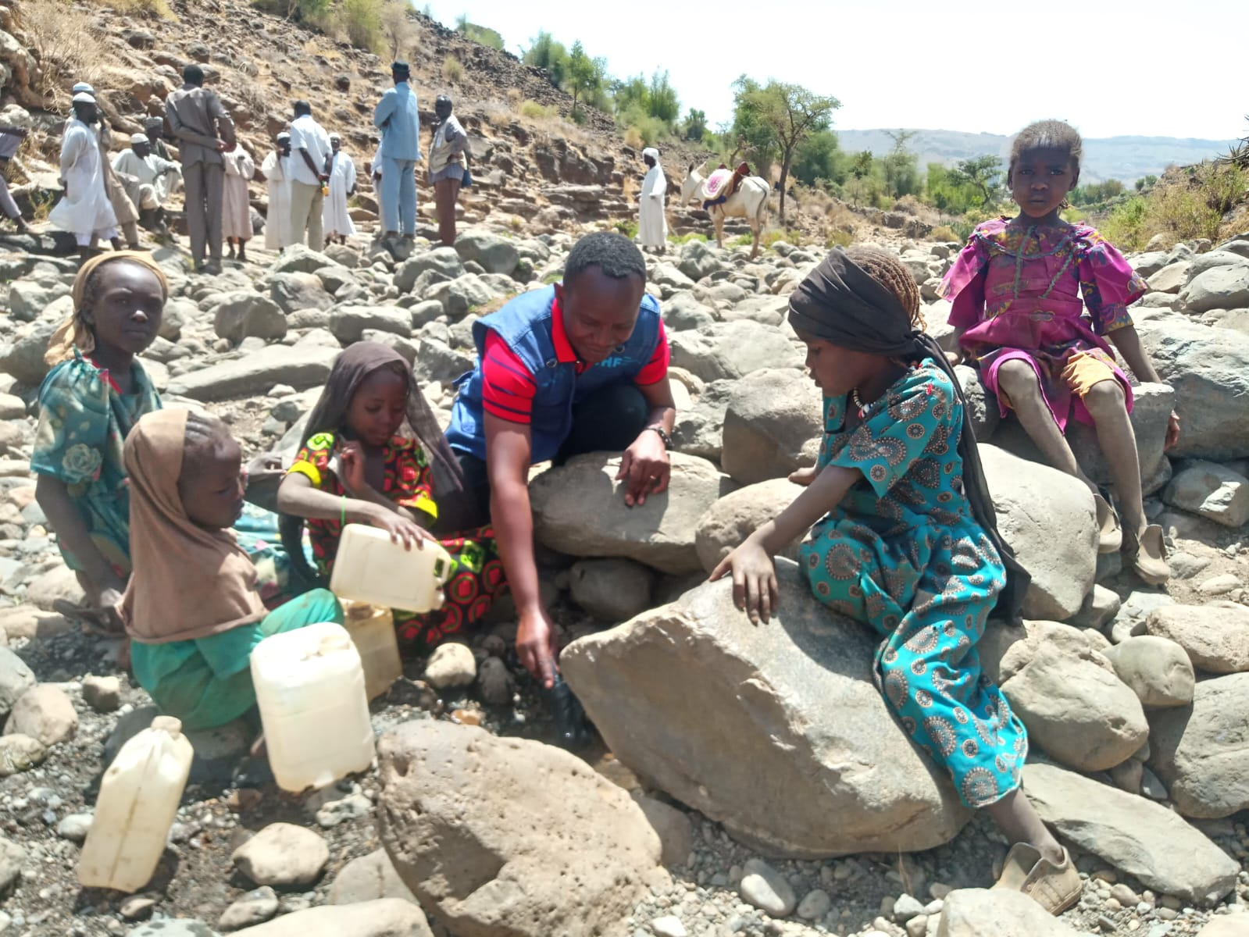
RESULT: SUDAN

Slide 18
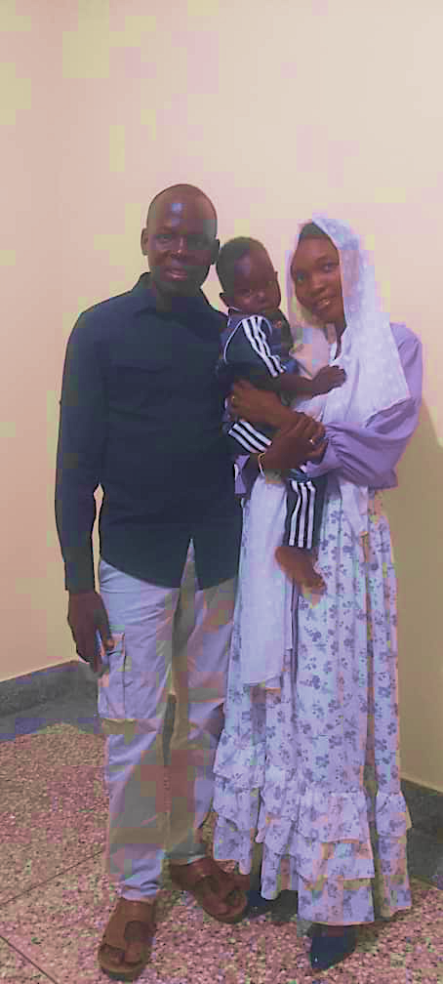
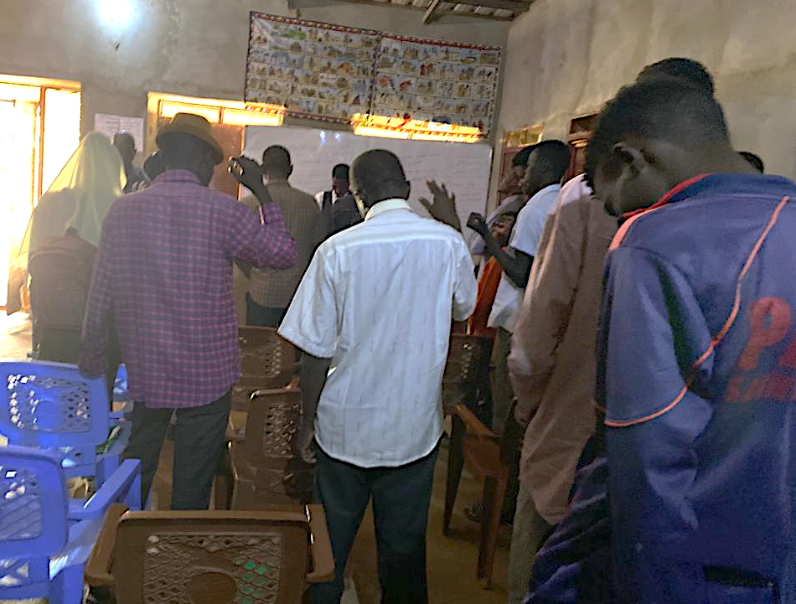
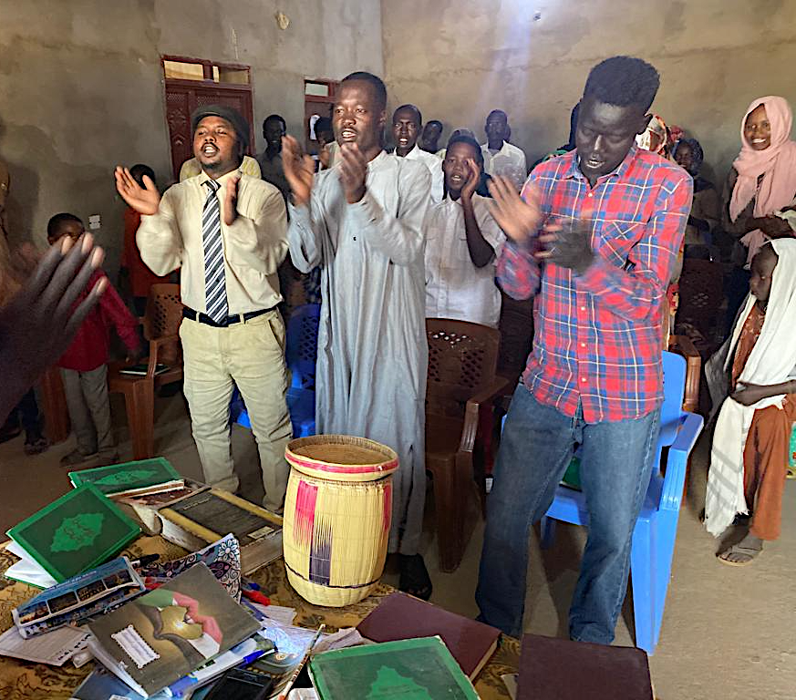
RESULT: SUDAN

Slide 19
KEY POINTS ABOUT INTEGRAL MISSIONS IN A CHRISTIAN MINORITY CONTEXT

