Slide 1
The International Landscape Today
Lanre Williams-Ayedun
Senior Vice President of International Programs

Slide 2
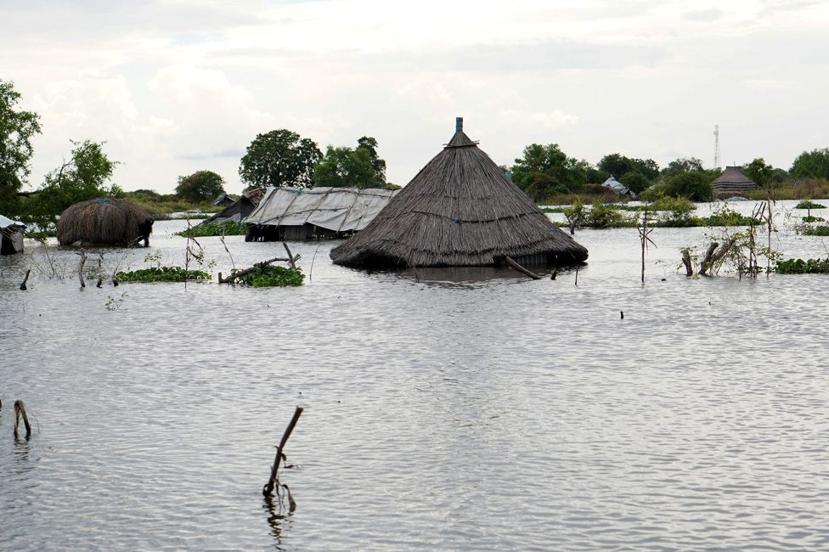

Slide 3
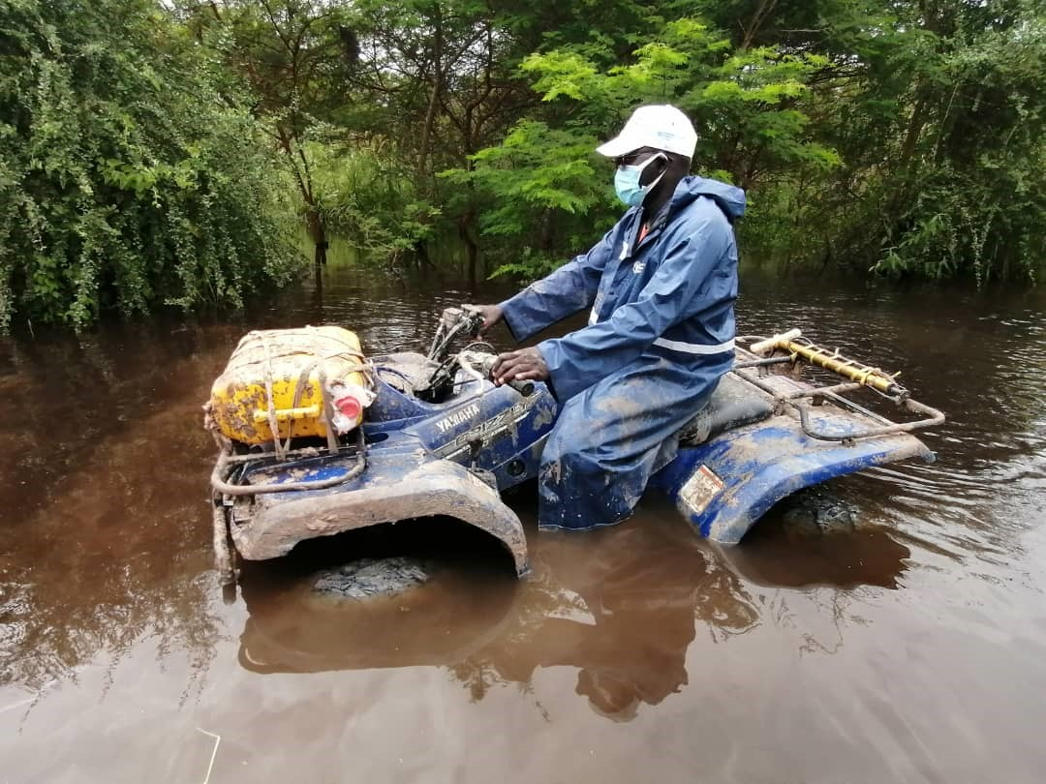

Slide 4
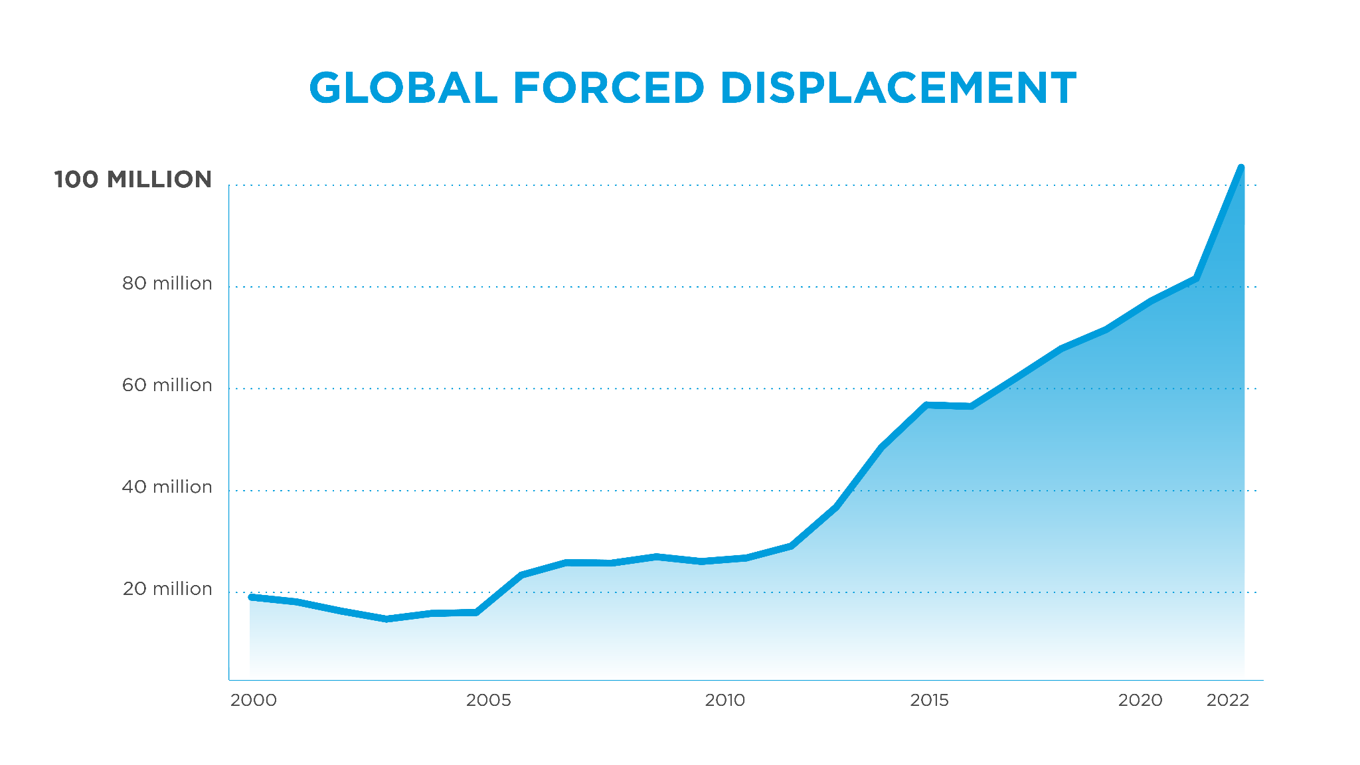
Hundreds of millions of people have been driven from their homes by three interconnected realities — violent conflict, climate change and extreme poverty.

Slide 5
COVID slowed poverty reduction. War in Ukraine & inflation also challenge progress

Slide 6
Confidence or trust in national governments and parliaments declining in the Global South

Slide 7
Open Doors Report, 2024:
Political instability, war and extremism has created a perilous situation for Christians. Amid lawlessness, jihadist groups have thrived. Weak governments fail to stop them.
Most Christians murdered for their faith in 2023 were killed in Sub-Saharan Africa.
Of 34.5 million displaced people across Sub-Saharan Africa, around 16.2 million are Christians.

Slide 8
exposure to risk +
insufficient coping capacities
=
fragility

Slide 9
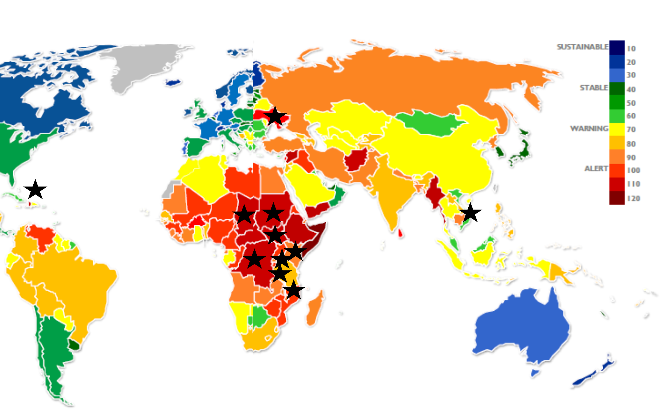
We are working together in the midst of fragility

Slide 10
Last year, we served 4,807,496 people, including:
558,000 people in Sudan
53,766 people in Turkey / Syria earthquake
6,250 people Israel and Gaza
17,038 people in Chad
340,000 people in Ukraine
6,364 people in DRC flood response

Slide 11
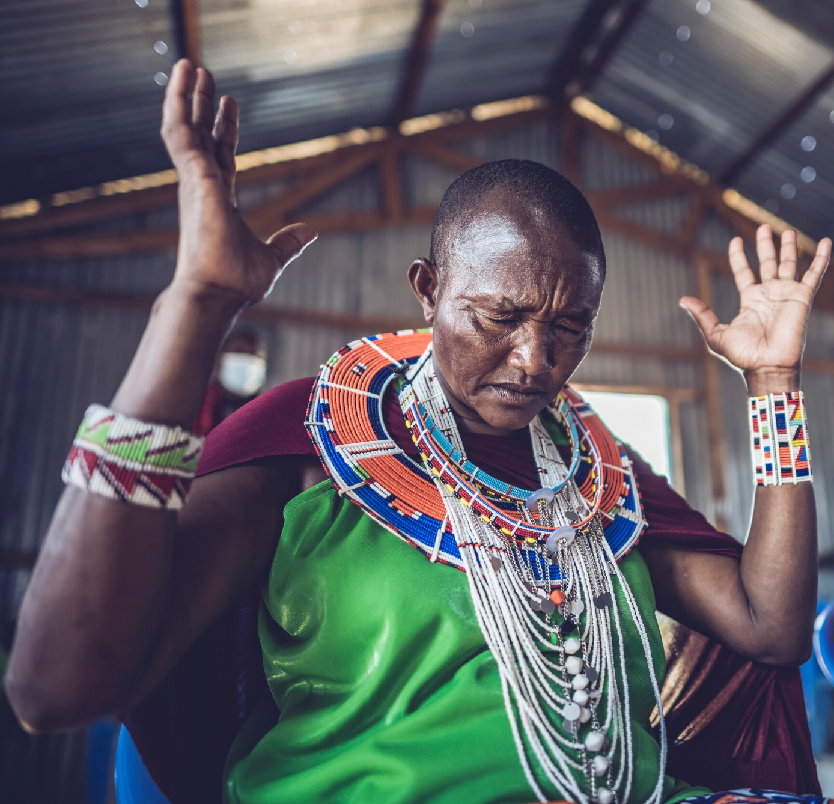
Church Empowerment Zones
34 CEZs in 8 countries
3,790 churches engaged
502,554 people served through CEZs, including 234,264 reached by CEZ outreach group volunteers

Slide 12
Flourishing!

Slide 14
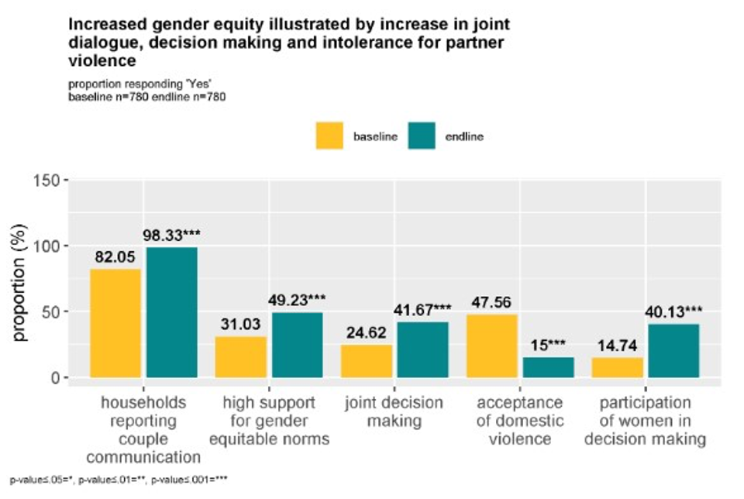

Slide 15
