Slide 1
This Moment
Jeff Walser
Vice President of Strategic Engagement Division

Slide 2
This moment...

Slide 3
I am astonished that you are so quickly deserting the one who called you to live in the grace of Christ and are turning to a different gospel— which is really no gospel at all.
Galatians 1:6-7

Slide 4
"We are hard pressed on every side, but not crushed; perplexed, but not in despair; persecuted, but not abandoned; struck down, but not destroyed"
II Corinthians 4:8-9

Slide 5
"I know that after I leave, savage wolves will come in among you and will not spare the flock"
Acts 20:29

Slide 6
" Look carefully then how you walk, not as unwise but as wise, making the best use of the time, because the days are evil."
Ephesians 5:15-16

Slide 7
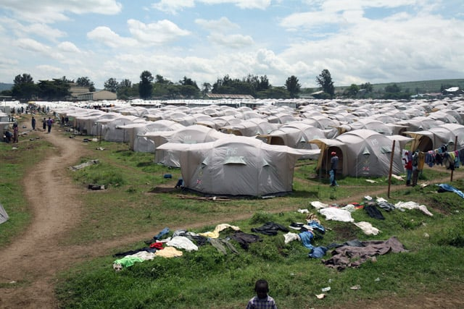
2009

Slide 8
DPP's

Slide 9
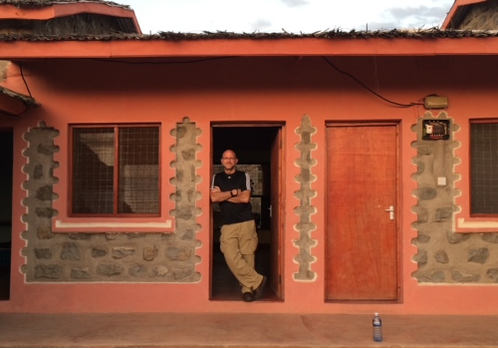
2013

Slide 10
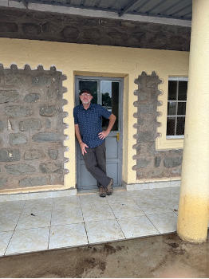
2013
2024

Slide 11
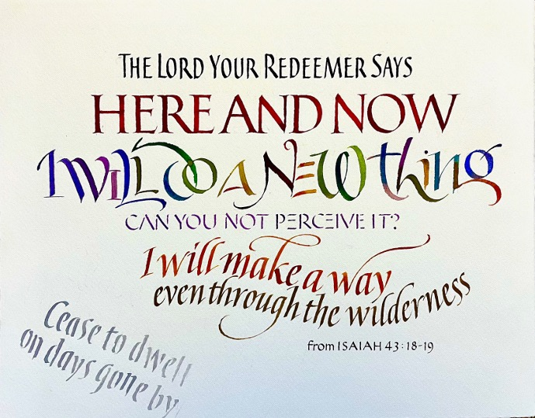

Slide 12
" Our past is not what we've left behind, it's what we carry... we are called to live forward given our history, bearing both its possibilities and its entanglements. Faithfulness is not loyalty to a past, but answering a call..."
James K.A. Smith
How to Inhabit Time

Slide 13
This moment...

