Slide 1
Where We’ve Been & Where We’re Going
Myal Greene
President & CEO

Slide 2
“In this world you will have many trials and tribulations, but take heart. I have overcome the world.”
— John 16:33

Slide 5
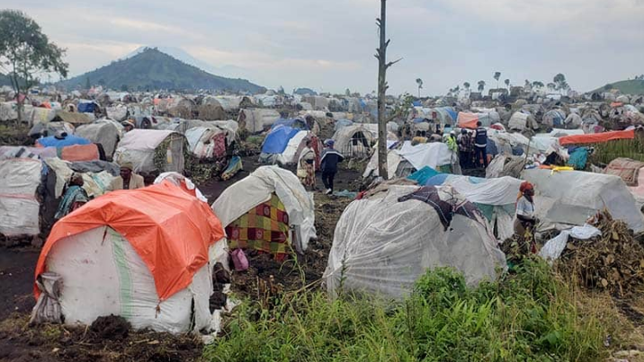

Slide 6
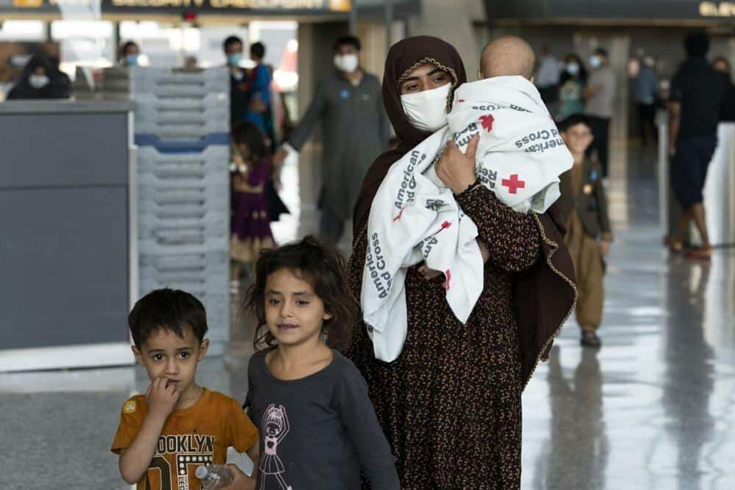
Afghan photos

Slide 7
His intent was that now, through the church, the manifold wisdom of God should be made known to the rulers and authorities in the heavenly realms, according to his eternal purpose that he accomplished in Christ Jesus our Lord. Ephesians 3:10

Slide 8
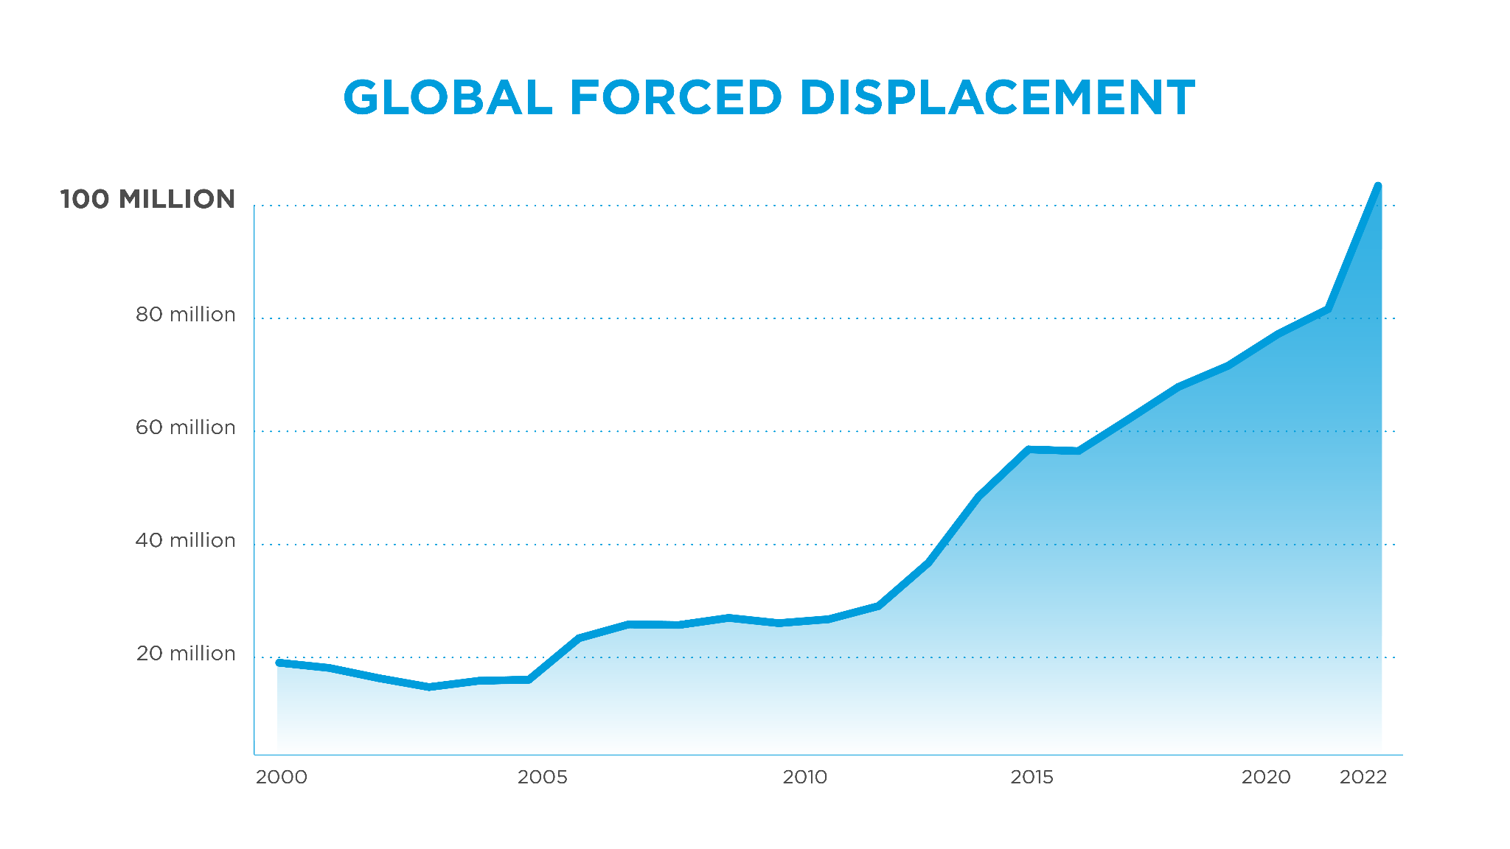
Notes:
For the first time in recorded history, the number of people who have been forcibly displaced from their homes has topped 100 million.
More than 32 million of these individuals are now formally designated as refugees, meaning that they have fled not just their homes but their countries as a result of a credible fear of persecution for reasons such as their race, their religion or their political opinion.
This is driven by rising global conflict over the last decade.
32 million refugees is double the number it was 15 years ago when I began my career as a humanitarian.
If you are like me, you believe the local church has a significant role to play in addressing this crisis.

Slide 11
Let us hold unswervingly to the hope we profess, for he who promised is faithful. And let us consider how we may spur one another on toward love and good deeds, not giving up meeting together, as some are in the habit of doing, but encouraging one another—and all the more as you see the Day approaching. Hebrews 10:23-25

Slide 12
Mission Statement:
Our mission is to boldly engage the world’s greatest crises in partnership with the church.
Notes:
“boldly engage” – Our programs, responses, and initiatives should be an intentional commitment to involve ourselves in challenging circumstances courageously and sacrificially.
“the world’s greatest crises” As a key distinctive, we are called to take on the greatest crises and challenges in the world, contributing to human vulnerability and suffering. At present, we recognize forced displacement, climate change, and the instability of fragile states among these crises. In the past, we have responded to the effects of wars, natural disasters and pandemics and global health emergencies.
“In partnership with” – We believe partnership is the best descriptor of our desired relationship with the church because it conveys a sense of collaboration, shared commitment, and mutuality while allowing for differing models of engagement. [potential add 1 sentence on models of partnership after church consultations complete]
World Relief’s Values note, “Partnership by seeking, facilitating, and promoting collaboration among all stakeholders, including local governments, the worldwide church, mission agencies, other NGO's, and the business community, recognizing partnership as essential to serving the most vulnerable. We believe each expression of the worldwide Church has a unique and interdependent role in bringing peace and justice to the world.”
“the church” - While World Relief is part of the universal church, it exists alongside local churches. Our distinct calling central to our mission as a parachurch organization (sodality of the church) is to partner with local churches (the modality of the church) as we contribute synergistically to God’s work of restoration in local communities.
World Relief’s Values note, “The Local Church as a primary agent of bringing peace, justice, and love to a broken world. The integrated "word" and "deed" dimensions of God's mandate, as evidenced through the church's integral, or transformational, mission are necessary to bringing reconciliation and restoration to God, others, and the environment.”

Slide 13
Vision Statement:
We envision thriving, welcoming communities where families flourish and people experience restorative relationships with God, their neighbors, themselves, and all of creation

Slide 14
“Weeping and crying no more… lives will not be cut short… people will build houses and dwell in them, and plant fields and enjoy them.”
— Isaiah 65

