Slide 1
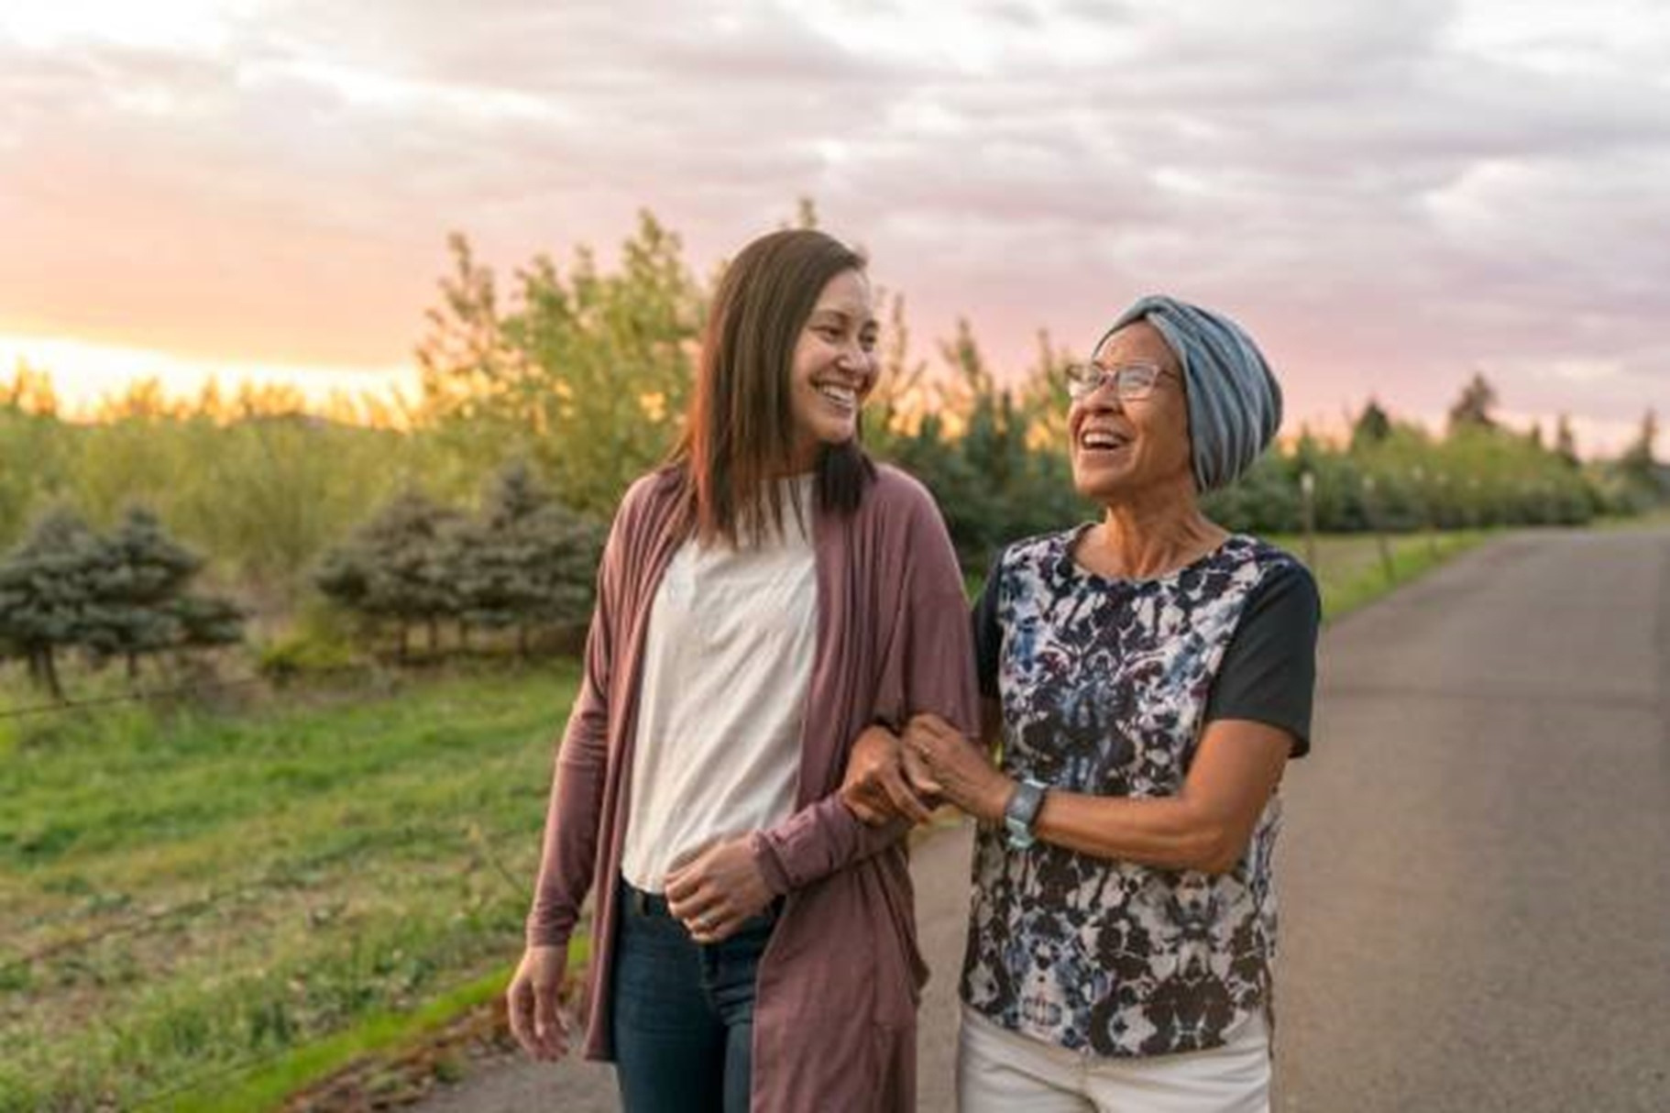

Good Neighbor Ambassador
TRAINING

Slide 2
PART 1:
HOW TO

Slide 3



DISTINCTIVES OF YOUR NEW ROLE
Ambassador as an advocate for refugees

Slide 4
DISTINCTIVES OF YOUR NEW ROLE
Ambassador as an advocate for refugees
Ambassador as a multiplier

Slide 5
DISTINCTIVES OF YOUR NEW ROLE
Ambassador as an advocate for refugees
Ambassador as a multiplier
Ambassador as a disciple

Slide 6

DISTINCTIVES OF YOUR NEW ROLE
Ambassador as an advocate for refugees
  Advocating for the most vulnerable
  Calling attention to the worldwide crisis
  Challenging with individual/group-sized call-to-action

Slide 7
DISTINCTIVES OF YOUR NEW ROLE​
Ambassador as an advocate for refugees
  Advocating for the most vulnerable
  Calling attention to the worldwide crisis
  Challenging with individual/group-sized call-to-action
Key Info
  The greatest displacement crisis in history
  100 million people displaced from their homes
  37,000 new people displaced each day

Slide 8
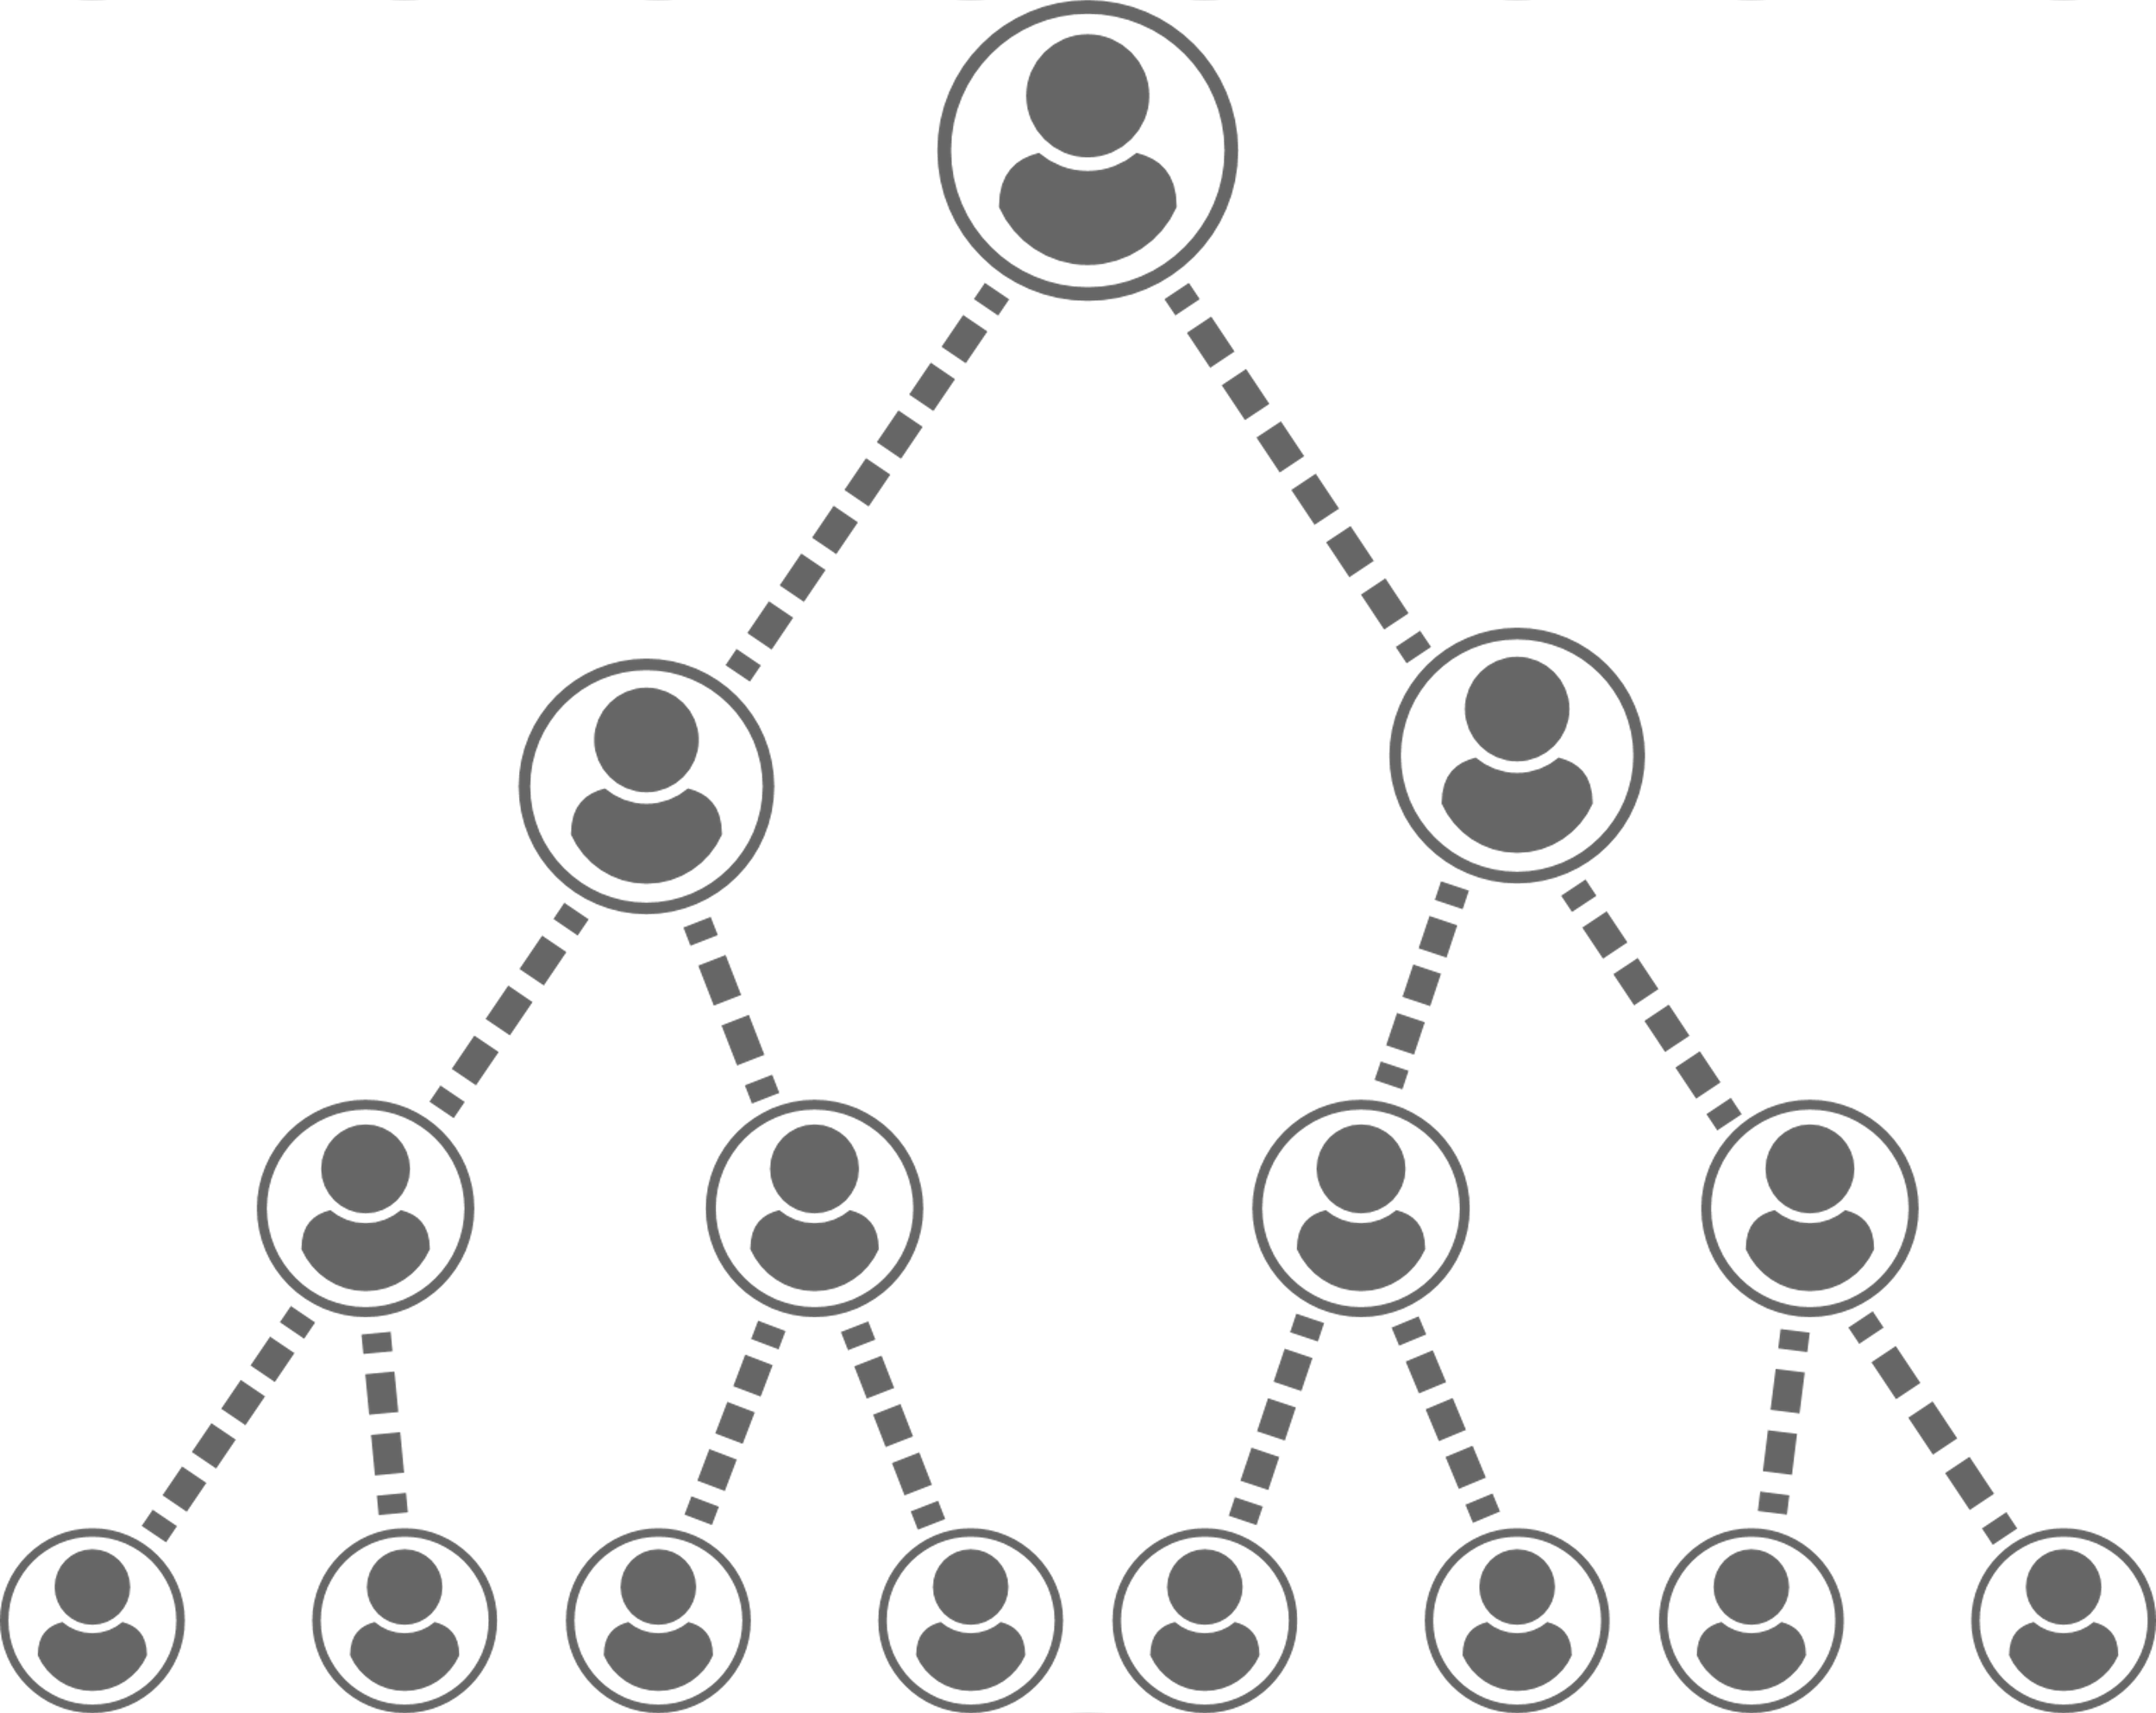
DISTINCTIVES OF YOUR NEW ROLE
Ambassador as a multiplier
  Doer vs Multiplier
  Multiplication vs Addition Growth
  Know your super power(s)!
  Your vision + personal goal

Slide 9

DISTINCTIVES OF YOUR NEW ROLE
Ambassador as a disciple
  Putting your own faith into action
  Growing in Biblical literacy about "the stranger"
  Encouraging others to put their faith into action
  Discovering your calling + spiritual gifts

Slide 10
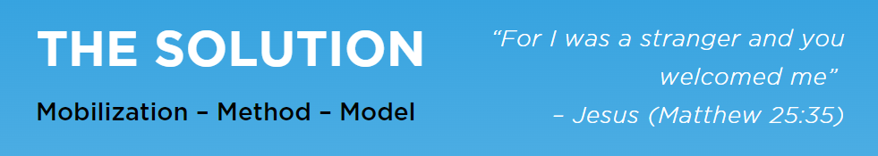
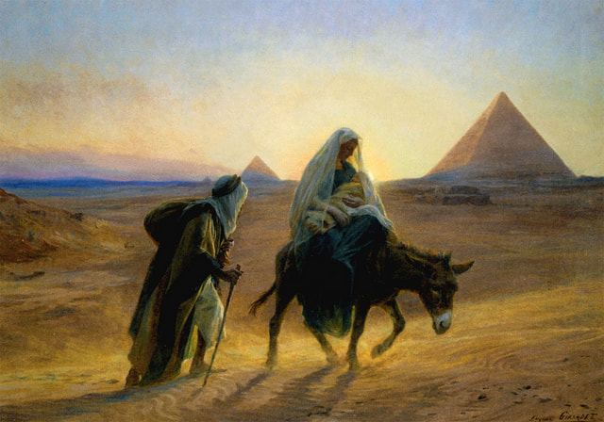
Notes:
What historical event does this painting depict?
Had you ever thought about Mary, Joseph and Jesus (aka The Holy Family) literally being refugees in Egypt?
How can this reminder help followers of Christ in the U.S. think/feel differently about refugees?

Slide 11

MOBILIZATION
  Who are we mobilizing?
  What are we mobilizing to do?
  Why are we mobilizing?
Notes:
WHO? The Body of Christ (local Christian churches)
WHAT FOR? For The Christian Church to be the solution to the worldwide displacement crisis.
WHY? Because of the "Great Commandment" ....Jesus replied: “‘Love the Lord your God with all your heart and with all your soul and with all your mind.’ This is the first and greatest commandment. And the second is like it: ‘Love your neighbor as yourself.
- Matthew 22:37-39
And God's heart for widow, orphans and "foreigners" as expressed throughout scripture.

Slide 12
METHOD
Extend W______________
+ Provide S______________
+ Build R_________________
= I_______________________
Notes:
Extent Welcome
Provide Services
Build Relationships
= Integration

Slide 13

METHOD

Slide 14
MODEL
FOR M______________ GROWTH
Notes:
M = Multiplication
Strength (…a cord of three strands is not easily broken. Eccl. 4:12)
Diversity (… God has placed the parts in the body, every one of them… 1 Cor. 12:18)
Sustainability (The Church grows through leadership development. Acts 6:1-7)
Note: Acts 6:1-7 is about the selection of the first deacons to care for widows (the vulnerable)

Slide 15
TEAM-BASED MODEL
Advantages of serving as a team?
  Strength
  Diversity
  Sustainability
Notes:
Multiplication Growth (not addition growth)
Strength
- Do more together
- Synergy
- Don't tire easily
Diversity
- Variety of skills
- Variety of personalities
- Variety of resources
Sustainability
- Encourage each other
- Replace lost members
- Plant new teams
- Continue with new leaders

Slide 16
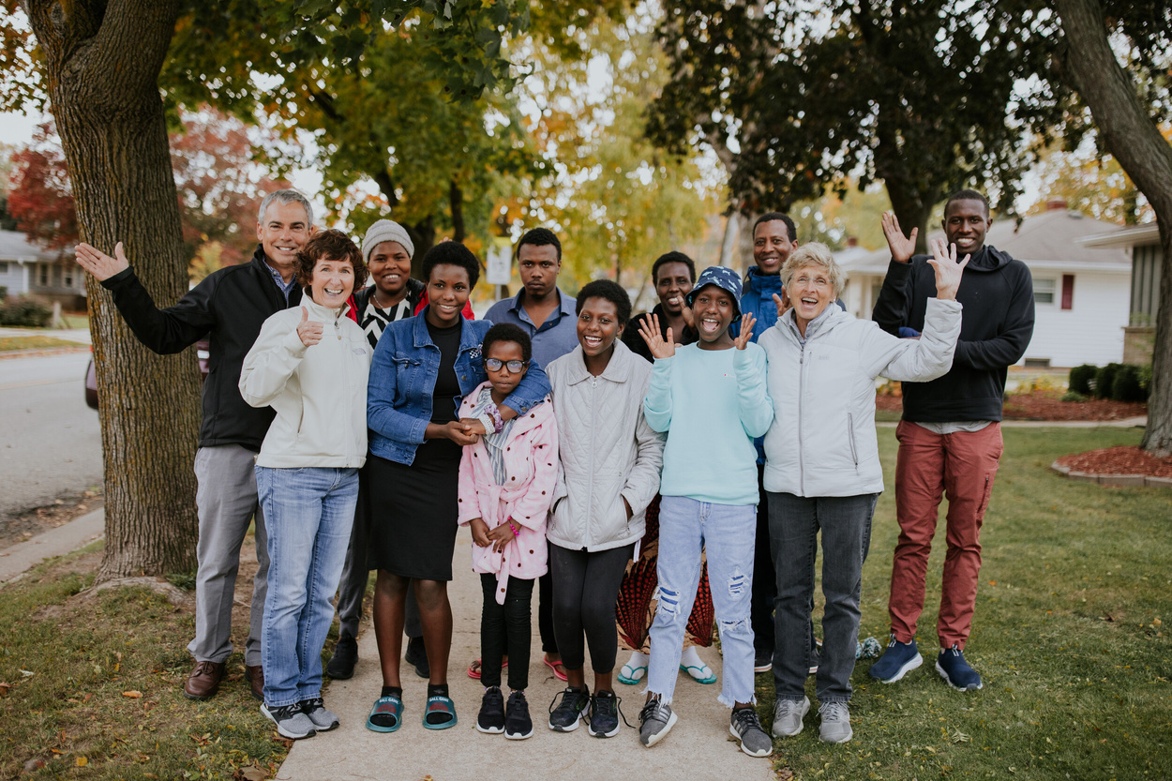
FOCUS IS ON TEAMS
  Starting a team
  Joining a team
  Teams from 2+ churches
Notes:
may add conversation about what kinds of churches might work well together if a single small church can't form a full team, etc.

Slide 17
FOCUS IS ON TEAMS
  Starting a team
  Joining a team
  Teams from 2+ churches
BUT TEAMS AREN'T FOR ALL
  I can't form a team
  I prefer an individual role
Notes:
We don't want this to be the end of the conversation is someone is not interested/able to join/start a team....

Slide 18
FOCUS IS ON TEAMS
  Starting a team
  Joining a team
  Teams from 2+ churches
BUT TEAMS AREN'T FOR ALL
  I can't form a team
  I prefer an individual role
SO WHAT IS PLAN B?
  Focus on high impact individual roles
  What are other priority roles in your region?
Notes:
Define high impact
Friendship Partner
Review other priority high impact roles in your region
Provide current short list of priority volunteer opportunities

Slide 19

AMBASSADOR COMMUNITY
  Meet / support / learn
  In-person events
  Facebook group
Notes:
facebook group TBD
Even if not scheduled, you can share about your own ideas for in-person events

Slide 20

TRAINING RESOURCES
  Me (your Ambassador Coach)
  Online toolkit includes:
    Ambassador Guide
    One Voice Guide
    Links to this training + more
    Social media tips
    Educational videos
Notes:
Note: Ambassador Coach is a role, and not your job title. In the future, it is possible that this role could be filled by an exceptional former ambassador....a next step in volunteer leadership development at WR.

Slide 21

PROMOTION PLAN
  Meet 1:1 to brainstorm your plan
Notes:
If you are training 1:1 and both you and ambassador have time, it's possible to due the promo plan at the end of the training.

Slide 22
PROMOTION PLAN
  Meet 1:1 to brainstorm your plan
  Plan will be unique to your interests, gifts, network

Slide 23
PROMOTION PLAN
  Meet 1:1 to brainstorm your plan
  Plan will be unique to your interests, gifts, network
  Some ideas:
    Networking with leaders
    1:1 meetings with individuals
    Small group presentations
    Large audience presentations
Notes:
Events at local churches*
Share with small groups*
Coffee with friends
Multi-ethnic dinner parties
Display materials at work
Mission conferences*
Social media promotion
Interview with local radio or newspaper
“Tag-team” presentations with refugee friend
Loss simulations
And more….
*emphasize need to coordinate with other staff or ambassadors about proposed churches to contact.

Slide 24
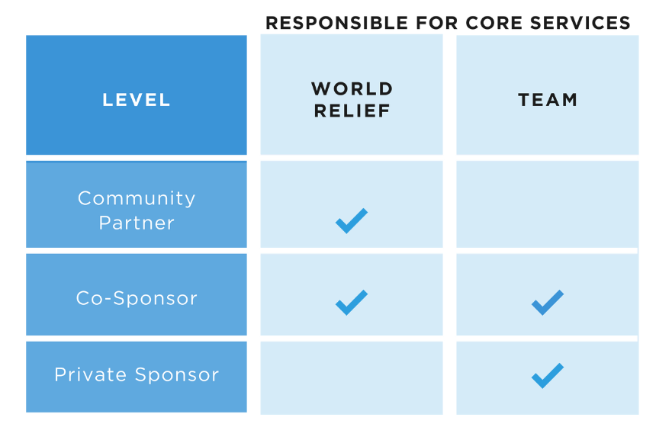
KNOW THE BASICS
What level was your team?
Notes:
Provide any relevant info about levels/types in your region.
Only Partner level?
New to Co-Sponsors ?
Any Private Sponsor pilot near your area?
etc
Remind ambassadors they don't have to explain the level options to potential teams. Informational only.

Slide 25



9 STABILITY FACTORS
  Core Services usually fall into these categories
  Can you remember 4 or 5 of these?

Slide 26
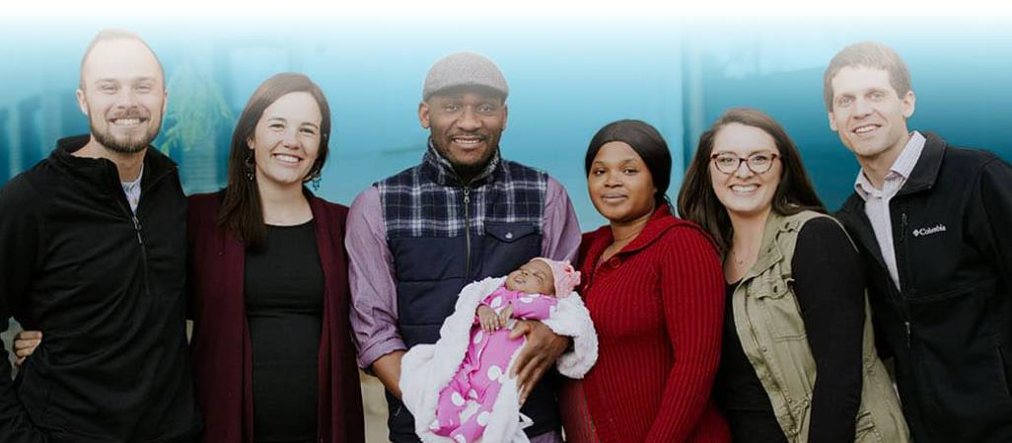
TEAM MEMBER ROLES
  Specific roles vary from team to team
  What are some common roles?
  Do leaders and member roles need to be decided before submitting the Interest Form?
Notes:
this can also vary from region to region.

Slide 27

CORE SERVICES
  What services did your team really enjoy?
  What services did your team find challenging?
Notes:
If training is 1:1 this may be a good time to talk about the level of his/her current or former GNT. And contrast to the experience that teams at other levels may have.

Slide 28

REPORTING
  Event Report
  Recruitment Impact
Notes:
Suggest Event Report training during the promo plan.

Slide 29
BREAK TIME

Slide 30
PART 2:
ONE VOICE

Slide 31

WORLD RELIEF IS A CHRISTIAN ORGANIZATION
Founded by NAE, a "home" for dozens of Christian churches, denominations, colleges, universities, and organizations.

Slide 32
HISTORY - KEY POINTS
  Global (both int'l and U.S. programs)
  First response: Relief for WWII victims in Europe
  Served over 100 countries / more than 75 years
  Focus: sustainable local church-based solutions
Notes:
World Relief is a global Christian humanitarian organization whose mission is to empower the local church to serve the most vulnerable. The organization was founded in the aftermath of World War II to respond to the urgent humanitarian needs of war-torn Europe.
Since then, for over 75 years, across 100 countries, World Relief has partnered with local churches and communities to develop sustainable, locally-driven solutions to some of our world’s greatest problems.
Learn more at www.worldrelief.org

Slide 33
WORLD RELIEF'S DNA
MISSION: To boldly engage the world's greatest crises in partnership with the church
Notes:
World Relief is a global Christian humanitarian organization whose mission is to empower the local church to serve the most vulnerable. The organization was founded in the aftermath of World War II to respond to the urgent humanitarian needs of war-torn Europe.
Since then, for over 75 years, across 100 countries, World Relief has partnered with local churches and communities to develop sustainable, locally-driven solutions to some of our world’s greatest problems.
Learn more at www.worldrelief.org

Slide 34
WORLD RELIEF'S DNA
MISSION: To boldly engage the world's greatest crises in partnership with the church
VISION: We envision thriving, welcoming communities where families flourish and people experience restorative relationships with God, their neighbors, themselves, and all of creation
Notes:
World Relief is a global Christian humanitarian organization whose mission is to empower the local church to serve the most vulnerable. The organization was founded in the aftermath of World War II to respond to the urgent humanitarian needs of war-torn Europe.
Since then, for over 75 years, across 100 countries, World Relief has partnered with local churches and communities to develop sustainable, locally-driven solutions to some of our world’s greatest problems.
Learn more at www.worldrelief.org

Slide 35
WORLD RELIEF'S DNA
MISSION: To boldly engage the world's greatest crises in partnership with the church
VISION: We envision thriving, welcoming communities where families flourish and people experience restorative relationships with God, their neighbors, themselves, and all of creation
VALUES: the example of Jesus, the local church, people, excellence, empowerment, partnership, prayer
Notes:
World Relief is a global Christian humanitarian organization whose mission is to empower the local church to serve the most vulnerable. The organization was founded in the aftermath of World War II to respond to the urgent humanitarian needs of war-torn Europe.
Since then, for over 75 years, across 100 countries, World Relief has partnered with local churches and communities to develop sustainable, locally-driven solutions to some of our world’s greatest problems.
Learn more at www.worldrelief.org

Slide 36

PRIMARY TARGETED AUDIENCES
Christian churches, organizations, and leaders
  Why include ethnic/immigrant churches?
  What are examples of church groups?
  What are examples of other Christian organizations?
  What are examples of church leaders?
Notes:
Christian Churches (includes ethnic / immigrant churches)
Church Groups (small groups, Sunday School classes, etc.)
Other Christian Fellowships (MOPS, InterVarsity, F3, Bible Study Fellowship, etc.)
Church Leaders (pastors, staff or non-staff leaders like Sunday School teachers, youth leaders, group leaders)

Slide 37

SECONDARY TARGETED AUDIENCES
  Individual church members
  Inactive World Relief volunteers
  The public (via social media)

Slide 38

NON-TARGETED AUDIENCES
  Non-Christian organizations (Why?)
  Schools (Why?)
  Difference between non-targeted VS excluded
Notes:
Non-Christian organizations
(NOTE: As a Christian organization, World Relief's mission is empowering churches and Christ followers.
Although non-Christians may engage with World Relief, our primary outreach efforts are focused on those who align with our mission, vision, and values)
Schools (World Relief has other opportunities better suited for students). Give examples for your region.

Slide 39
SIMPLIFIED
BRAND GUIDE

Slide 40
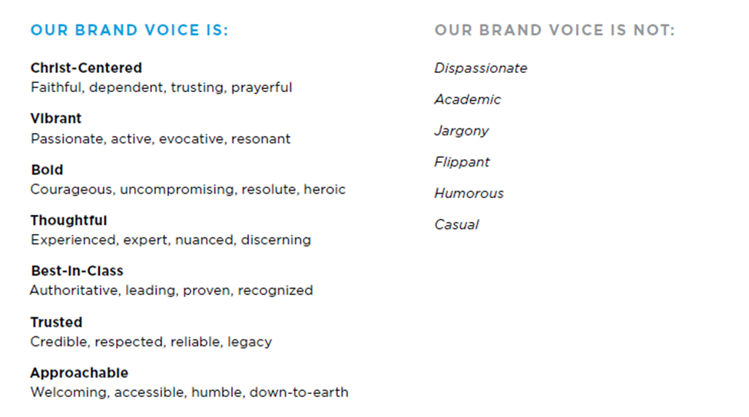
VOICE
Notes:
WR's voice is like the personality of the organization.

Slide 41


VOICE
GOOD EXAMPLE: extend your church's compassionate embrace to refugees, providing welcome, support, and a beacon of hope in their time of need.
BAD EXAMPLES:
  Jargony
  Academic
  Flippant
Dispassionate
Humorous
Casual
Notes:
Jargony: urgent appeal for the implementation of comprehensive R&P assistance mechanisms to mitigate displacement-induced distress and foster socioeconomic inclusion in host communities.
Academic: empirical evidence and humanitarian principles indicate a demand for increased support and protection for refugees.
Flippant: I know there's a zillion causes, but let's lend a hand to those awesome refugees and make the world a better place for everyone!
Dispassionate: among other global trends, the number of displaced persons has increased recently.
Humorous: time to show refugees some love and laughter – let's help them find new homes while learning some refugee camp jokes!
Casual: hey peeps! Go help a refugee find some new digs – be the difference!

Slide 42
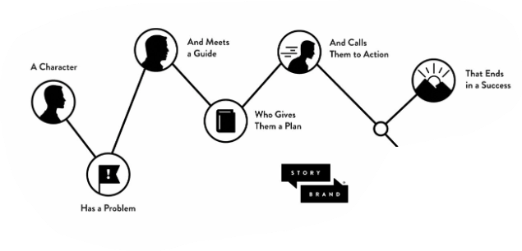
STORY BRAND

Slide 43
STORY 1: CHURCH HAS A PROBLEM
Our members are not growing in their faith or leadership due to a lack of hands-on ministry opportunities where they can put their faith into practice.
  Guide?
  Our solution?
  Call to action?
Notes:
Guide: World Relief
Our Solution: We can help your church build a ministry with the local refugee community.
Call to Action: Get started by learning about Good Neighbor Teams.

Slide 44

STORY 2: CHRISTIAN HAS A PROBLEM
I'm concerned about the refugees who are moving into our community. I want to help but don't know how.
  Guide?
  Our solution?
  Call to action?
Notes:
Guide: World Relief
Our Solution: Educate yourself about refugees and get involved in their lives.
Call to Action: Get started by joining a Good Neighbor Team.

Slide 45
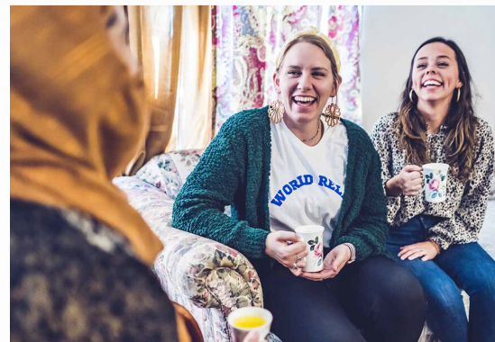
ETHICAL STORYTELLING
  Written Consent Form
  Whole story
  Accurate story
  Do not exaggerate
  Respect privacy
Notes:
Dignify the subject of the story by:
Getting written consent with official Consent Form
Telling the whole story accurately to reflect the context (or part they are willing to share)
Not sensationalizing or exaggerating their story
Respecting their privacy (avoid using their real name or sharing details they are not comfortable sharing, ex: painful/traumatic past)
Learn more by taking the “Ethical Storytelling” Workshop Course
https://worldrelief.thinkific.com/courses/world-relief-ambassadors

Slide 46

SOCIAL MEDIA

Slide 47
SOCIAL MEDIA
  Not required for ambassadors
  If you do, post the disclaimer on the bio for each of your channels
  What is a qualifying channel?
  When can you create original content?
  Example of appropriate personal comment with shared post
Notes:
Disclaimer: "The posts on this site are my own personal opinions. They do not necessarily represent the views and opinions of anyone else or any organization."
Qualifying Channels: for each channel (TikTok, Instagram, Facebook, etc.) you use to share WR content, you commit that all other content posted on that channel is consistent with WR's values (i.e., no inappropriate language, vulgar jokes, etc.). If there is content that is deemed inappropriate, than there is a risk of dismissal from your ambassador role.

Slide 48
SOCIAL MEDIA
Appropriate personal comments when sharing or posting:
  Consistent with:
    World Relief's mission, vision, and values
    One Voice Guide
    Your role as an ambassador
  Avoid:
    Political commentary or judgement
    Divisive comments or statements

Slide 49
SOCIAL MEDIA
You are responsible for monitoring your posts. Appropriate replies to others' comments or questions:
  Brief but accurate
  Refer reader to World Relief office if not 100% sure about subject
  Remove abusive or highly negative comments
Notes:
Remember, you are responsible for monitoring the content you post. If someone responds to your post and you wish to reply, please keep these things in mind.

Slide 50

SOCIAL MEDIA
Your Channels vs World Relief's Channels:
  Follow World Relief's channels to re-share official content
  Use your own (qualified) channels to post promotion content for the Good Neighbor Program.
  Copy + paste content from online toolkit
  No original content
  No photos of refugee families
Notes:
By posting or re-sharing the official World Relief content, it helps us speak with One Voice.
If you have photos you'd like to share/use, you can get the Consent Form signed by subjects and submit them for consideration in future promotions.

Slide 51
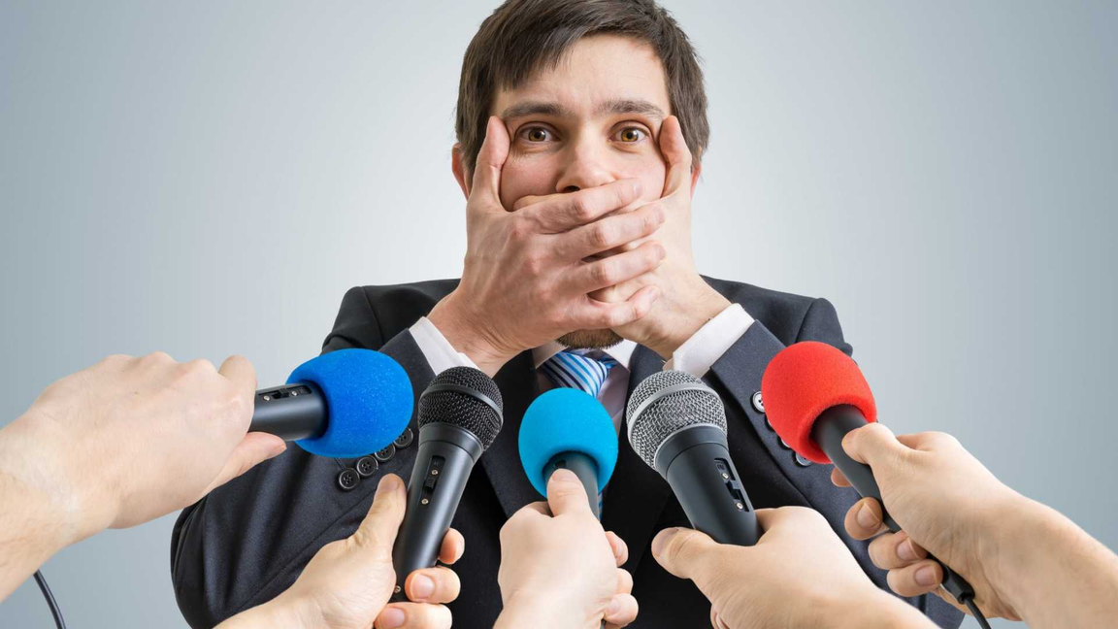
MEDIA RELATIONS – KEY REMINDERS
  No media outreach without express written permission
  Share opportunities with your Ambassador Coach
  World Relief has a national PR firm
  PR firm coordinates interviews
Notes:
Ambassadors cannot directly engage media outlets (radio, TV, print, other) without express authorization.
If you know of a media interview opportunity and are interested, please communicate it with your staff supervisor and/or office director. They will follow up on the opportunity with our national PR firm. If it is determined that it is appropriate for you, as an ambassador, to be interviewed, the PR firm will provide coaching and scheduling for the interview, etc.

Slide 52


VISUAL BRANDING – KEY REMINDERS
World Relief has strict brand guidelines:
  Do not design new literature or graphics
  Do not copy and paste logo or graphics
  Print on white paper only
Notes:
You should not encounter a need to produce new materials, or utilize the World Relief logo, official colors, etc.
If you do have a need, please communicate with your Good Neighbor Ambassador Coach.
Under no circumstance should you "copy and paste" the World Relief logo, photos, or other official content from either the website, printed, or digital resources to create original content of your own design.
Do not edit any existing resources, print on colored paper, etc.

Slide 53

VOLUNTEER IDENTITY
Use official title: Good Neighbor Ambassador
Don't use: GN Ambassador, GNA, Ambassador, etc.
How could your role be confused with a staff role (on purpose or accident)?
Notes:
Always refer to your role using the official title. Refrain from abbreviating your title to avoid organization specific jargon.
Example of how this role could be confused for a staff role: if a Good Neighbor Ambassador added the World Relief website or phone number to their email signature. This is an example of what not to do.

Slide 54
PREFERRED TERMINOLOGY
Why are these preferred? What alternatives are not preferred?
  Christian
  Refugees and other vulnerable immigrants
  Local [World Relief] Office
  Those experiencing poverty
  Developing country
  Good Neighbor Team
  Church members/leaders
Notes:
Speaking w/one voice.
Christian (not evangelical, Jesus people, etc.)
Refugees or other vulnerable immigrants (not illegal aliens, foreigners, strangers, etc.)
Local [World Relief] Office (not affiliate office, chapter, etc.)
Those experiencing poverty (not the poor, the down and out, etc.)
Developing country (not third world, undeveloped country, etc.)
Good Neighbor Team (not GNT, GN Team, etc.)
Church members (not laity, lay people, etc.)
Church leaders (not clergy, priesthood, etc. Unless you are sure of the jargon of that particular denomination)

Slide 55

Congratulations on becoming a
Good Neighbor Ambassador!

