Slide 1
Contagious Fragility: A Case Study on Responding to the Sudan Crisis from Chad
AidEx 2024 – Geneva, Switzerland – 24 October

Slide 2
15 April 2023

Slide 3
Introduction
Presenters
Contributors
Lanre Williams-Ayedun Senior Vice President, International Programs
Joshua Meares Country Director, Sudan
Andrew White Program Officer, Sudan & Disaster Response
Gemta Birhanu Deputy Director, Humanitarian & Disaster Response Unit

Slide 4
Fragility in Sudan and Across Borders
Breakdown of a single-source humanitarian supply line for critical programmatic supplies
The impact of hyper-inflation – 245% in 2023 and an estimated 150% in 2024
Breaking of the social fabric
A relational society
National borders divide communities
Loss of critical members of society
Re-traumatization of an entire population

Slide 5
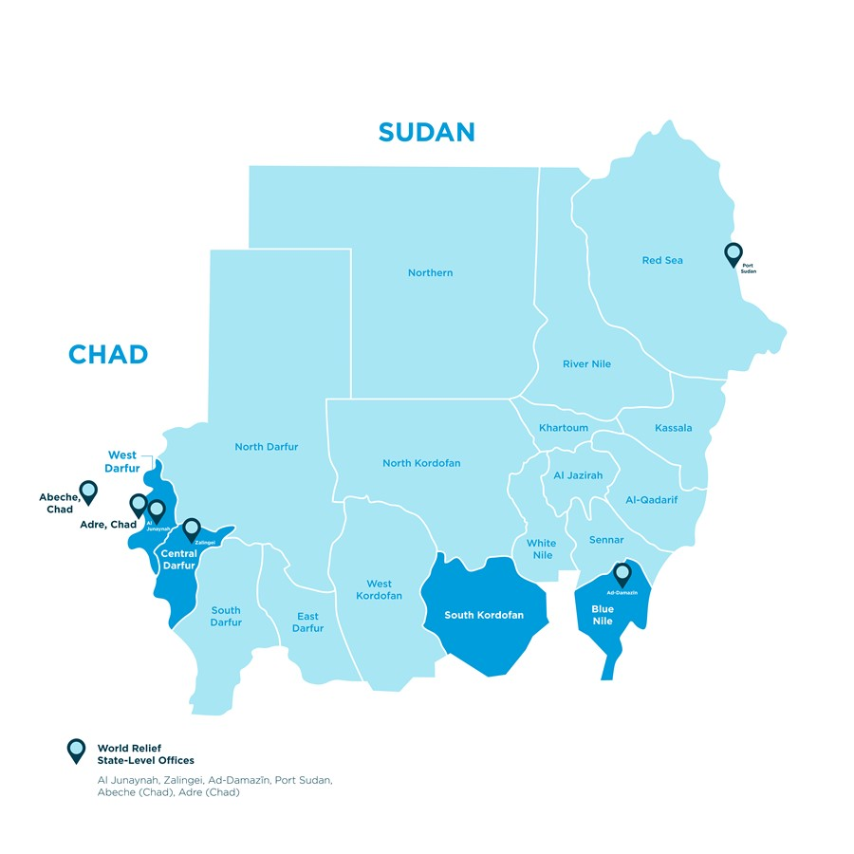
WR Sudan Profile
Established in 2004
Active in West Darfur, Central Darfur, Blue Nile, South Kordofan, and Khartoum (pre-conflict)
Over 300 staff (including 13 expatriate staff), plus an additional 400 seconded government staff

Slide 6
WR Sudan Profile (cont.)
Focused on humanitarian and development projects in multiple sectors, including:
Health
Nutrition
WASH
Agriculture
Food Assistance
Food Security and Livelihoods
Protection
Peacebuilding
Annual Budget: approx. $20 million (USD)
Diverse funding mix:
USAID-BHA
OCHA managed Sudan Humanitarian Fund (SHF)
WFP
UNICEF
UNHCR
BMZ
EKN
DRA
Private funding

Slide 7
Summary Timeline
December 2022 – Country Office established in Chad
15 April 2023 – War breaks out in Khartoum and quickly spreads across much of Sudan
23-26 April 2023 – Evacuation of the humanitarian community from Sudan
11 June 2023 – World Relief establishes an emergency response team in Chad
24 July 2023 – World Relief Program Director is the first international humanitarian to return to West Darfur
2 August 2023 – World Relief begins the first distributions in West Darfur since the start of the war, reaching 15,000 people with in-kind food

Slide 8
Overview of One Year of Response
Key Accomplishments in Sudan
Provided humanitarian services to 996,251 people
Food: reached 293,865 people with 2,509 Metric Tons of food and provided food and cash vouchers to 139,260 people in West and Central Darfur.
Non-Food Items: distributed basic essential items (i.e. jerrycans, washing basins, cooking utensils, etc.) to 18,600 households of displaced people.

Slide 9
Overview of One Year of Response (cont.)
Health: provided primary health care services to 214,320 displaced people through 30 fixed facilities and 15 mobile clinics.
Nutrition: screened over 20,000 children for malnutrition and referred 2,150 children for treatment of severe acute malnutrition (SAM).

Slide 10
Overview of One Year of Response (cont.)
WASH: provided drinking water for 243,211 people through construction and rehab. of infrastructure and water-trucking to gathering points of displaced people.
Protection: provided community protection and gender-based violence services to 45,300 people.

Slide 11
Overview of One Year of Response (cont.)
Key Accomplishments in Chad
Nutrition: screened 14,112 children and treated 2,400 for SAM
Protection: served 2,500 at risk individuals and trained 15 volunteers
WASH: upgraded a borehole to a mini-water yard to now serve 4,100 people per day

Slide 12
Success Factors
Discussed from a Leadership perspective and a Programmatic/Operational perspective

Slide 13
Success Factors – Leadership Perspective
Well-Established Program
Diverse Staff
Experienced Senior Leadership
Strong Donor Relations

Slide 14
Success Factors – Leadership Perspective
Decentralized and Flexible Control Models
Trust in a Strong Team
Rapid Decision Making
Providence
Office in Chad

Slide 15
Success Factors – Programmatic/Operational Perspective
Well-Established Program
Community-Based
Integrated Humanitarian and Development Programs
Multiple Field Offices

Slide 16
Success Factors – Programmatic/Operational Perspective
Decentralized and Flexible Control Models
Quick Deployment of Team to Chad
Flexible Funding

Slide 17
Success Factors – Programmatic/Operational Perspective
Providence
Banks
Geographic Spread

Slide 18
Key Principles Learned
Also discussed from a Leadership perspective and a Programmatic/Operational perspective

Slide 19
Key Principles Learned – Leadership Perspective
Fog of War
Push decisions down as far as possible
“Good enough”

Slide 20
Key Principles Learned – Programmatic/Operational Perspective
Presence
Single-source supply chain inadequate
Do no harm in Chad

Slide 21
| Q & A |

Slide 22
Sources
African Development Bank Group – Sudan Economic Outlook
Clingendael – From Catastrophe to Famine: Immediate action needed in Sudan to contain mass starvation
IOM – Regional Sudan Crisis Response Situation Update #57 - 4 September 2024
NRC – 10 things to know about the neglected emergency in Chad
OCHA – Sudan Humanitarian Update (1 September 2024)
UNHCR – Sudan Situation: UNHCR External Update #77, 30 August – 5 September 2024
WFP – Sudan Emergency Overview
WHO – Health Cluster Sudan Bulletin (June - July 2024)

