Slide 1




FAMILIES ARE IN CRISIS
Will you step into your calling to help them?

Slide 2





Step into your calling to welcome the stranger.
worldrelief.org/stand-in-the-gap

Slide 3
FAMILIES ARE IN CRISIS
Will you stand
in the GAP?
worldrelief.org/stand-in-the-gap

Slide 4


Set aside February 14 as a national day of prayer.
worldrelief.org/stand-in-the-gap

Slide 5
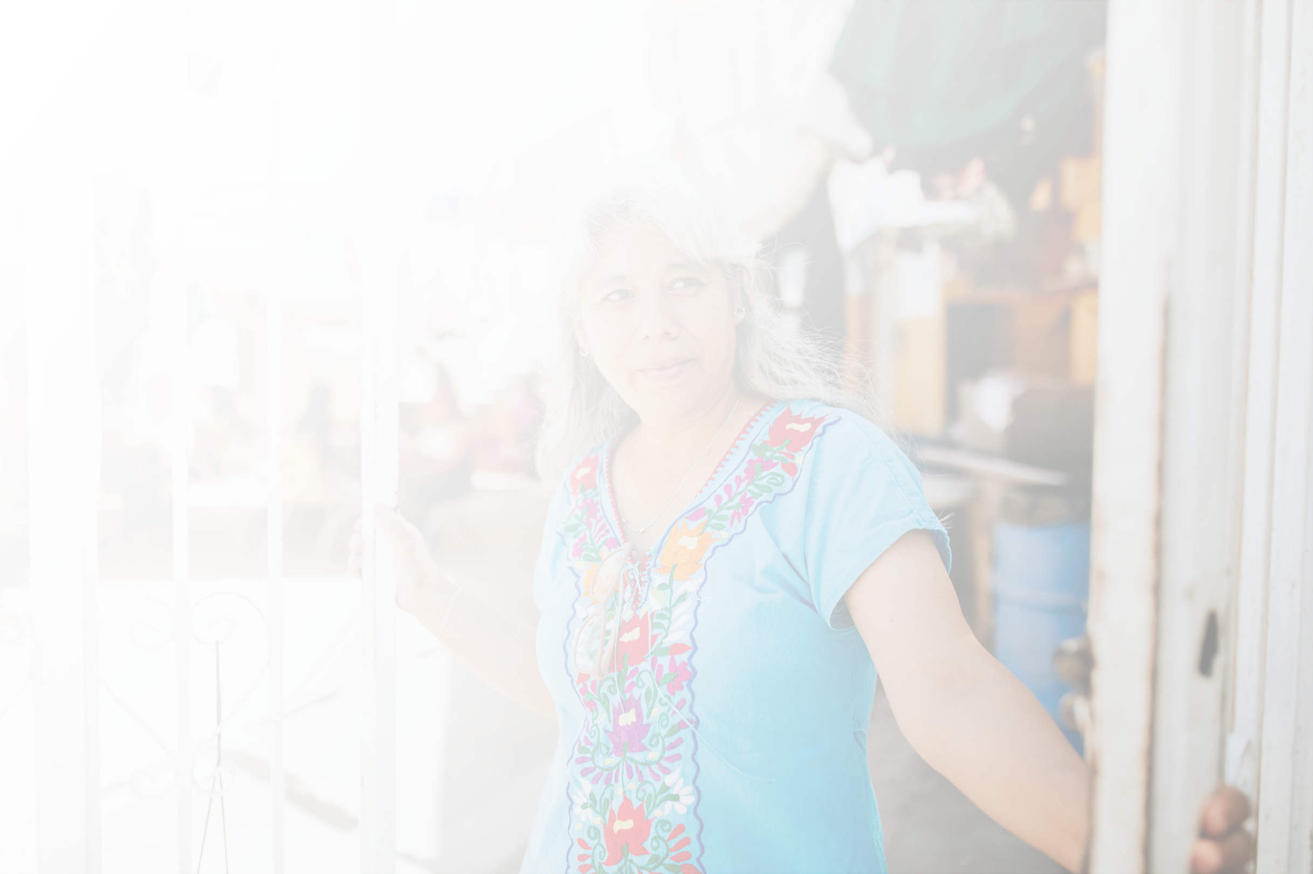


Will you stand
in the GAP?
worldrelief.org/stand-in-the-gap

Slide 6
Let us be the church. Let us put faith in action to help millions in need.
Stand in the gap today!
worldrelief.org/stand-in-the-gap

Slide 7
Will you stand
in the GAP?
Give. Advocate. Pray. Share.
We believe that prayer is powerful and effective! Join us in setting aside February 14 as a national day of prayer.
worldrelief.org/stand-in-the-gap

Slide 8
Stand in the GAP today!
Critical funding for nearly 4,000 refugees we serve in the U.S. has stopped abruptly. We are also deeply concerned about funds for sustaining our life-saving work overseas.
Will you BE the church to the millions
in need?
Give. Advocate. Pray. Share.
worldrelief.org/stand-in-the-gap

Slide 9




Will you stand
in the GAP?
$12,000
covers rent and utilities for 1 family for 3 months
$30,000
provides employment services to help 40 refugees
supports a staff team of 5 to help newly arrived refugees get the resources they need.
$60,000
worldrelief.org/stand-in-the-gap

Slide 10

FAMILIES ARE IN CRISIS
Will you stand in the gap?
$12,000
covers rent and utilities for 1 family for 3 months
worldrelief.org/stand-in-the-gap

Slide 11
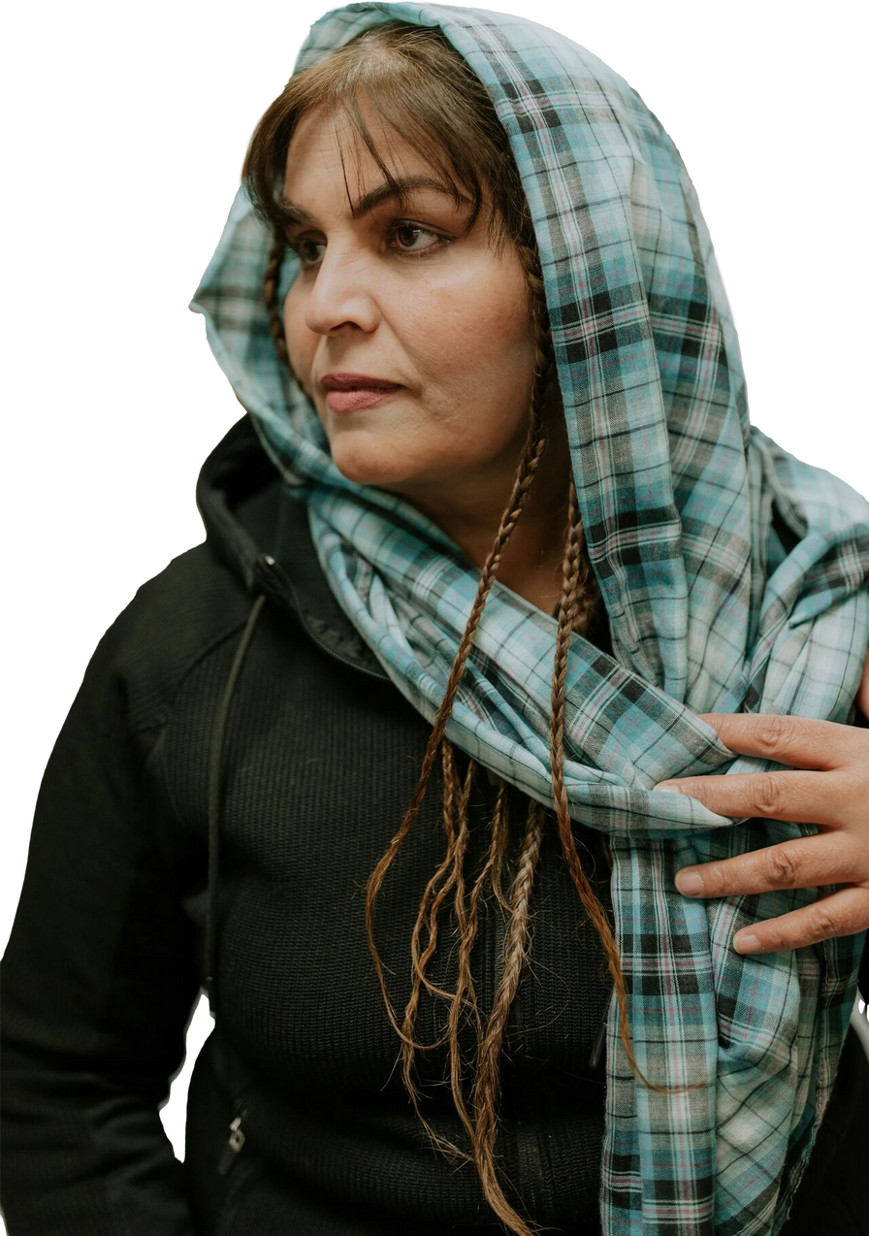

FAMILIES ARE IN CRISIS
Will you stand in the gap?
$30,000
provides employment services to help 40 refugees
worldrelief.org/stand-in-the-gap

Slide 12


Will you stand
in the GAP?
$12,000
$30,000
covers rent and utilities for 1 family for 3 months
provides employment services to help 40 refugees
$60,000
supports a staff team of 5 to help newly arrived refugees get the resources they need.
worldrelief.org/stand-in-the-gap

