Slide 1




State of Refugee & Immigration Policy
Matthew Soerens
Matthew Soerens

Slide 2
Recent Changes to Refugee & Asylum Policy
Suspending refugee resettlement indefinitely
Suspending funding for recently-resettled refugees already resettled to the US
Shutdown of asylum appointments at lawful ports of entry via the CBP One app at the US-Mexico border, plus expansion of Biden-era restrictions on asylum eligibility for those who cross without inspection between ports of entry
The administration has proposed dramatic cuts to funding for adult education programs, including English language instruction
Recent legislation made refugees ineligible for food stamps (SNAP, effective this year) and Medicaid (starting in 2026) until they receive their green cards, not until at least one year after arrival and often much longer

Slide 3
Recent Changes to Immigration Enforcement
Expanding priorities for deportation – putting those without criminal convictions at risk alongside those with criminal convictions – and terminating longstanding guidance limiting immigration enforcement in churches and other “sensitive locations”
Cancellation of humanitarian parole sponsorship programs for Venezuelans, Cubans, Haitians, Ukrainians and others
Termination of humanitarian parole status for Cubans, Haitians, Nicaraguans & Venezuelans who entered via airports and for those who entered lawfully at the US-Mexico border using the CBP One app (status for Ukrainians and Afghans with humanitarian parole less clear)
Actual scope of deportations are limited by resource constraints, but Congress has recently appropriated a very large amount of money for immigrant detention & deportation operations

Slide 4
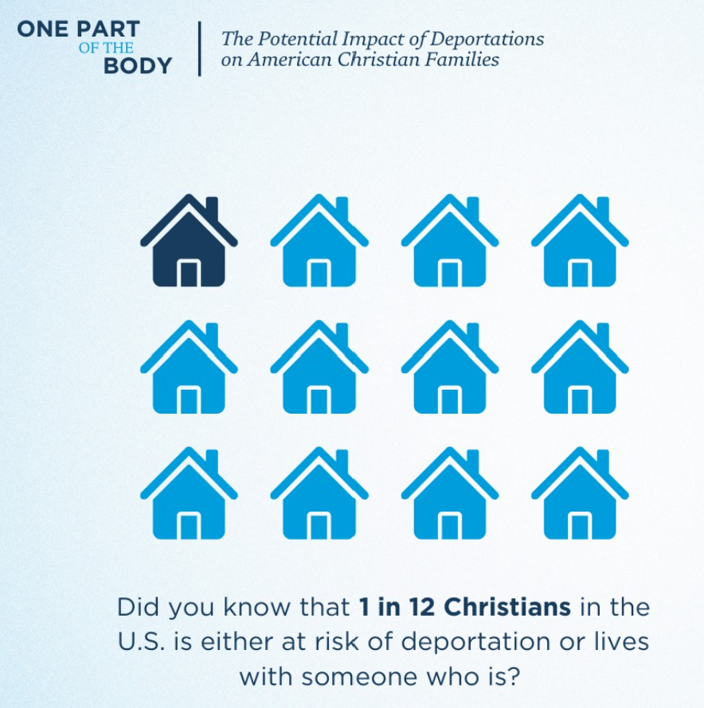
Significant Impacts on the US Church
If all those legally vulnerable to deportation are actually deported, that would mean the removal of 10 million Christians from the U.S., plus impact 7 million U.S. citizens who live in the same households (Center for the Study of Global Christianity)
1 in 12 Christian households could be directly affected

Slide 5
Impact on Immigrant Families
Kevenson from Haiti
Afghan Christians
Stephanie in California
Pastor Fernando from Mexico

Slide 6
Evangelicals’ Views on Immigration
Thousands of evangelical leaders have affirmed an Evangelical Statement of Principles for Immigration Reform, urging bipartisan solutions that:
Respects the God-given dignity of every person
Protects the unity of the immediate family
Respects the rule of law
Guarantees secure national borders
Ensures fairness to taxpayers
Establishes a path toward legal status and/or citizenship for those who qualify and who wish to become permanent residents
Each of these principles is supported by at least 74% of evangelical Christians in a Lifeway Research survey conducted earlier this year
76% say they would support legislation pairing an earned path to citizenship for the undocumented with border security improvements
70% of evangelical Christians believe the US has a moral responsibility to receive refugees
67% want those convicted of violent crimes deported, but less than 20% say those brought as children, parents of US citizen children or those willing to pay a fine as restitutio should be a deportation priority
Notes:
- I find this polling helps put leaders at ease: the sort of policies we’re advocating are actually not far outside of the evangelical mainstream, but views held by roughly three-quarters of their congregants, most likely

Slide 7
An Alternative That Honors the Law & Protects Family Unity
World Relief and our Evangelical Immigration Table partners have long advocated for immigration reforms that would:
Make it harder to immigrate illegally, including by investing in border security
Make it easier to immigrate legally, particularly to meet the needs of the U.S. labor market, to reunite families more quickly and to offer refuge to some of the most vulnerable who have fled persecution
Allow those who are unlawfully present but have not committed serious criminal offenses to make things right by paying a fine and earning the opportunity to stay lawfully in the United States
A current bipartisan bill, the Dignity Act (H.R. 4393), follows this outline closely — but is unlikely to get a vote without significant advocacy

